Slide 1

It’s easy to create your own #wastesectorsayszero photo frame!
Like the examples below; take a picture of yourself with ‘Zero’ on your hand
Then using the last slide with the blank frame, add your picture and then click ‘send to front’ on the frame to it covers your photo
Click File>Save as and then choose JPEG for the file type.
When you hit ‘save’ it will ask if you want to save all slides or just this one, clikc ‘Just This One’ and it will save your image as a photo
Post to social media and don’t forget to tag @hopeforjusticeint and use the hashtag #wastesectorsayszero

Slide 2

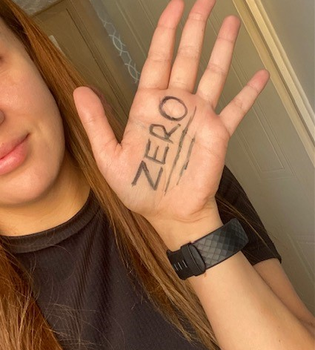

Slide 3
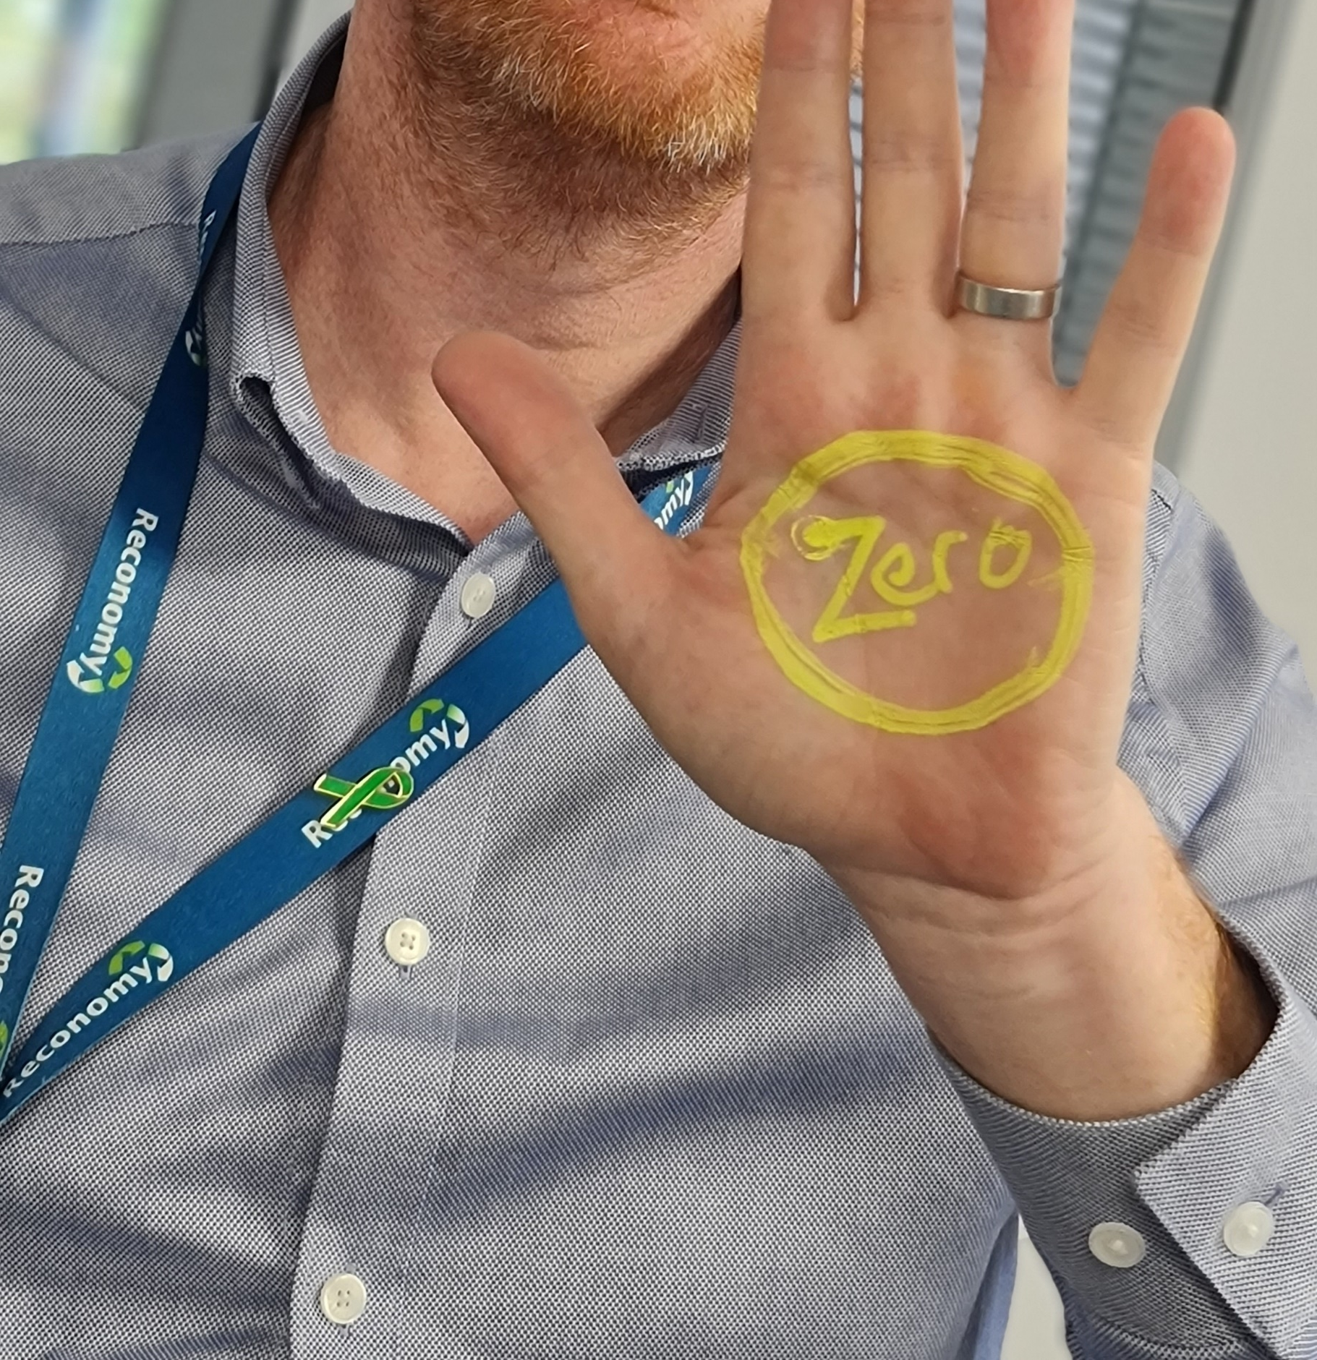

Slide 4
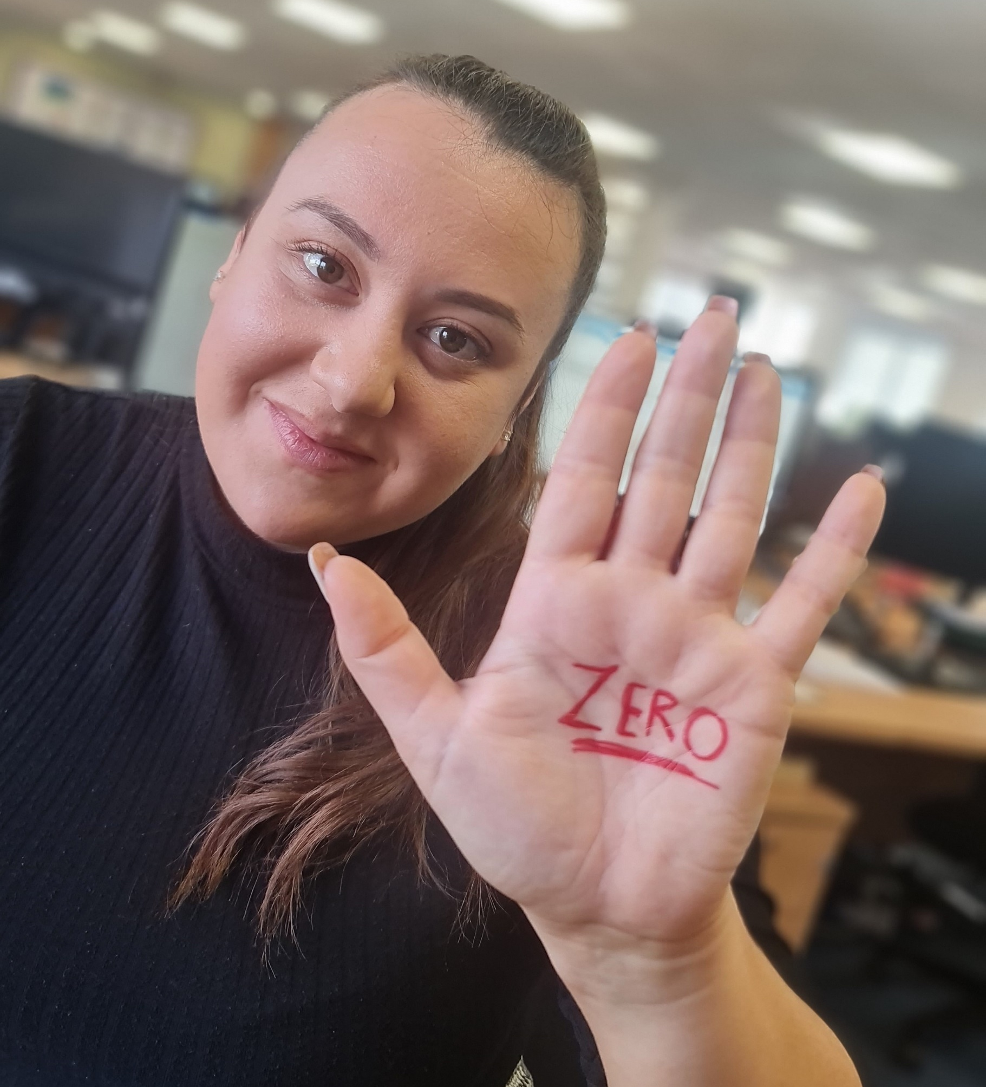

Slide 5


Slide 6
