Slide 1



Case Study
Plastic film and flexibles (FFs) separation at a Material Recovery Facility (MRF)
From: CIWM’s Strategic Expert Group (SEG) Infrastructure, Services and Operations (ISO)

Slide 2
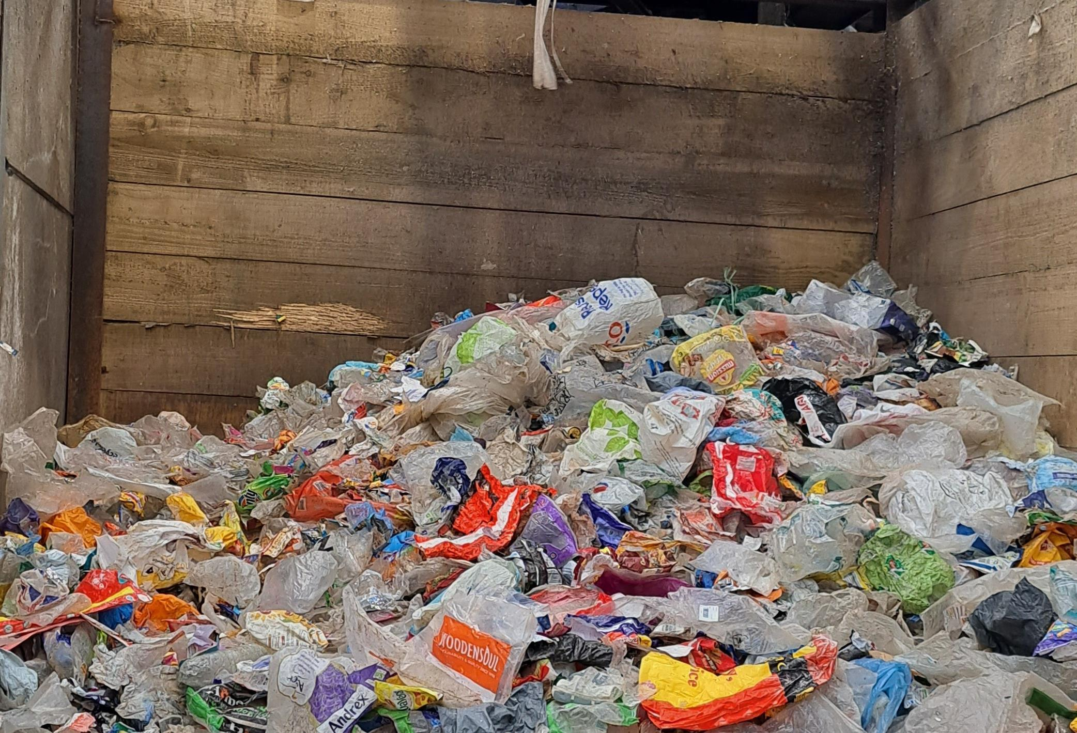
Introduction
CIWM’s Infrastructure, Services and Operations Strategic Expert Group (SEG) has been set up to consider and champion practical aspects of infrastructure, services, and operations, within the resources and waste sector. This SEG is about the essentials of what needs to happen to make materials and resources move to places/markets, supporting the circular economy transition.
The SEG has produced a case study
of a materials recovery facility (MRF) that has adapted its operations and processes to incorporate the collection of films and flexibles.

Slide 3

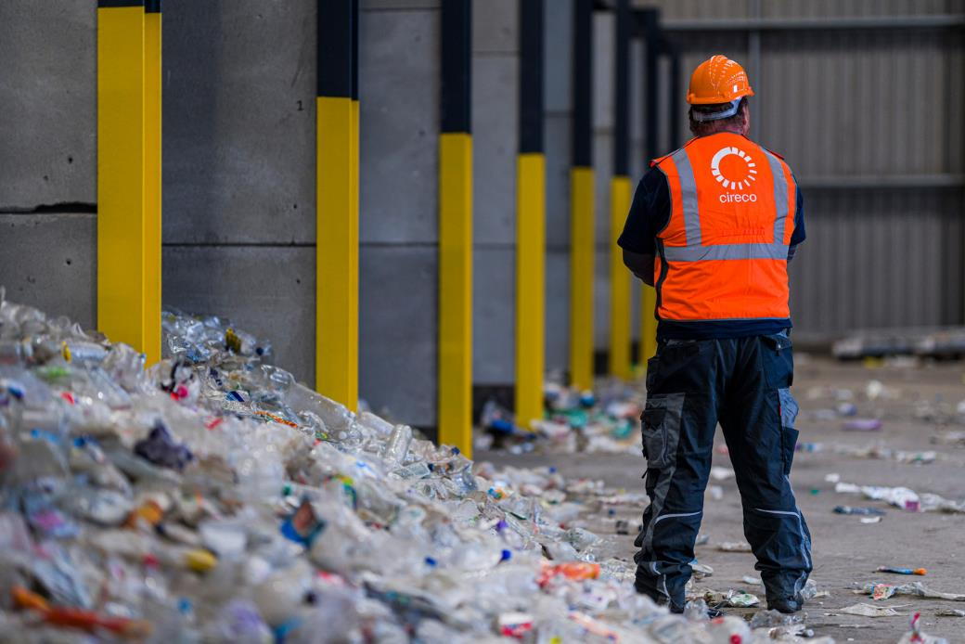
Background
  Cireco Scotland’s MRF separates flexible plastics like pet food pouches, bread bags, crisp packets, etc., as well as traditional plastic, metal and fibre fractions.
  Composition analysis showed that 14% by weight of residual waste is films and flexibles (FFs).
  In January 2022, Fife Council added film and flexibles to the 3D collections for 185,000 households across Fife.
  The collection system captures film and flexibles along with 3D plastic & cans on a 4-weekly basis.
  There was no change to frequency, bin type or collection vehicles. Making this system very easy for the public to get on board with, no collection system changes and with no negative carbon impact.

Slide 4


MRF and collection system set-up
Material Memory | NIR split | Collection Patterns | Optimization
FFs plastic fill in the voids in the 3D recyclables collection container The film, with its low memory, is loosened when tipping by the high memory container mix By volume, FFs represent one of the biggest elements of residual waste | The Recycling Improvement Fund (Scottish Government) provided an additional Tomra NIR optical sorter to directly enable the splitting of plastic fractions to allow the targeting of FFs This helped to split out the flexible/pots, tubs and trays element from the other fractions split previously | The MRF operates on a batch process, to maximise the effectiveness of the sorting equipment Fife Council altered collections, when bringing the processing of 2D&3D material in house, to enable 2D material to be processed for 2 weeks, then 3D material for the following 2 weeks | Air lift technology was then employed to drive out more film from the process and settings altered to optimise the capture of material Alterations were made to the setting on other equipment to improve targeting and presentation of materials The Cireco facility is a non-glass MRF
+
+
=

Slide 5
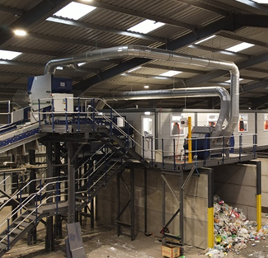
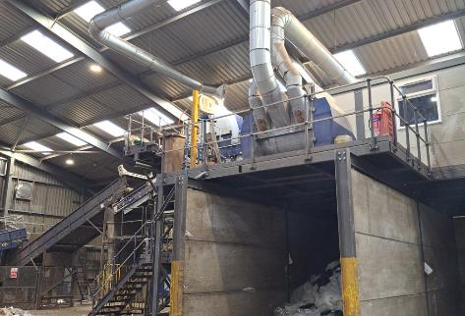
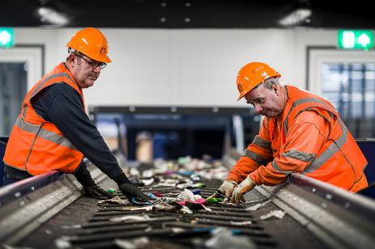
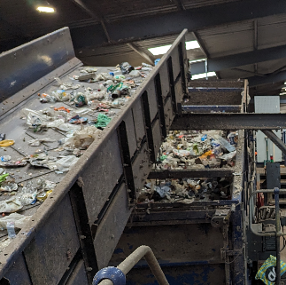
MRF Process - 1 of 2
  FFs are removed with a Westeria air lift – this takes off large pieces of film and flexibles.
  Following this in the pre-sort cabin, operatives take off large film such as furniture bags as well as removing waste and gross contamination (microwaves, brake discs, kettlebells etc., that the public manage to put in a wheelie bin).
  A ballistic screen follows the air lift and pre-sort. In a dry mixed recycling setting (DMR) this would split paper and carton from cans and plastics, but this is adjusted to split the film (which acts like 2D material) from the 3D like containers.

Slide 6
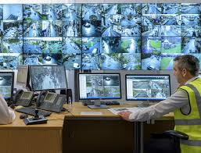
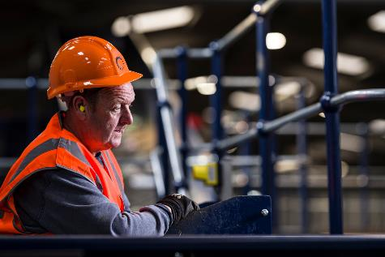
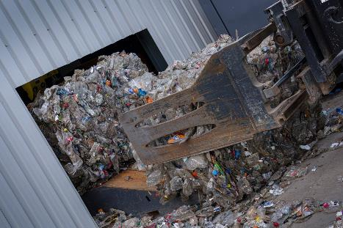
MRF Process - 2 of 2
  However, on cans and plastics (with film and flexibles) there is a need to speed up and adjust the angle to make film behave like paper, migrating to top of the screen.
  Much of this stream is plastic film with some paper and other contamination (e.g., nappies) which needs a light pick to improve the quality for onward processing as MRF films.
  The 3D material that comes off the bottom of the ballistic drops vertically between two transfer conveyors, where a cyclone is used to draw off the light material.
  Here any film and flexibles caught within the container mix are removed and clean MRF grade films are captured.
  From this point optical sorting follows, splitting out the remaining material into PET, HDPE Natural/White, HDPE Coloured and PTT/PP.
  Additional picking at this stage is carried out by operatives to improve the output quality.

Slide 7


Process learning 1 of 2
  It has been found that the ballistic separator is a key component in the processing of F&F. A higher speed means more material reaches the top as it has more velocity to travel, separating out film and flexibles from rigged 3D materials.
  With a lower bed angle and slower speed the majority of material falls to the base of the unit.
  With the higher angle, cans and containers still go to the bottom, but lighter film moves up the bed.
  Experimenting with these settings has helped Cireco to optimise the capture of materials for different stream types and compositions.
  At the time of this case study write up (April 2024) the MRF was capturing 3,000 tonnes of film, which equates to 316g/hh/wk.

Slide 8
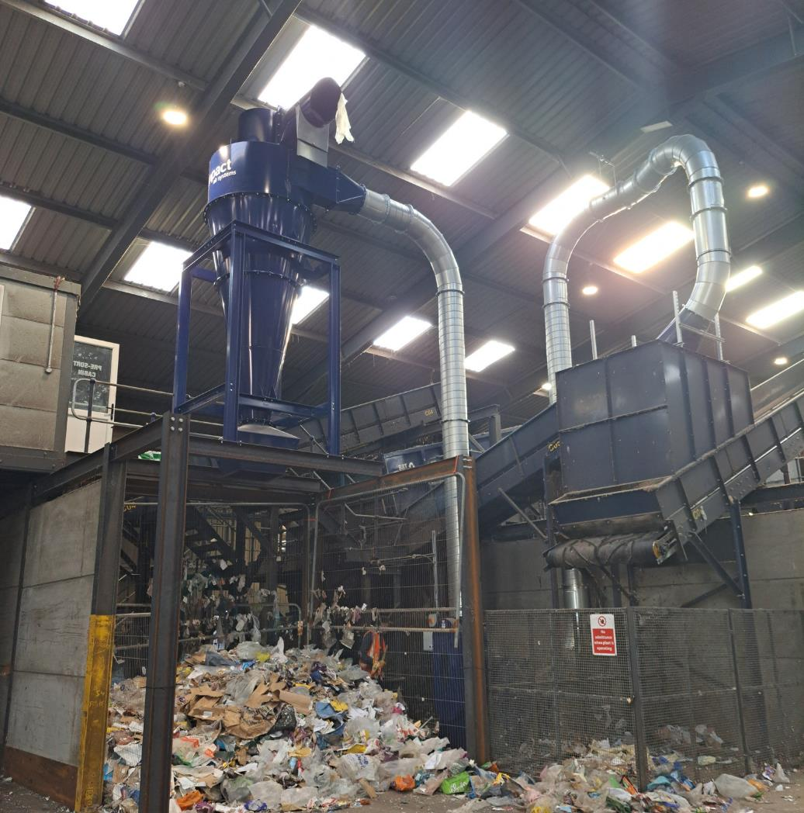
Process learning 2 of 2
  The cyclone also improves the presentation of material to the optical sorters further down the process line.
  Cireco are considering another cyclone at the end of the plant to pick out as much remaining F&F before going across to the Tomra sorter.
  The set up protects high value items.
  The addition of the cyclone has increased the volume of film recovered, compared to just using the flat plane Westeria lift.
  The induction element of the system has been refined over time and is now automated to allow blockages to be cleared more easily and to reduce items such as cardboard being brought through.

