Slide 1
Welcome to the
Sustainability & Resource Awards
2016

Slide 2
Chris Murphy
Deputy Chief Executive CIWM

Slide 4
#ciwmawards

Slide 5
LUNCH

Slide 6
Chris Murphy
Deputy Chief Executive CIWM

Slide 7
Alistair McGowan

Slide 8
Roger Perry Award
for Best Research Paper

Slide 9
Roger Perry Award
for Best Research Paper
Colin Williams
‘An investigation into the contributory factors to contamination in household recyclate collected by local authorities in England and the impacts of this contamination’

Slide 10
Waste Regulation Award

Slide 11
Waste Regulation Award
John Galvin MBE
‘A two–part perspective on tackling and preventing waste crime and entrenched poor performance in the waste industry’

Slide 12
James Jackson Award

Slide 13
James Jackson Award
Professor Ian Williams, Peter Shaw & Andrea Rispo
' Source segregation and food waste prevention activities in high-density households in a deprived urban area’

Slide 14
PEEL People’s Cup

Slide 15
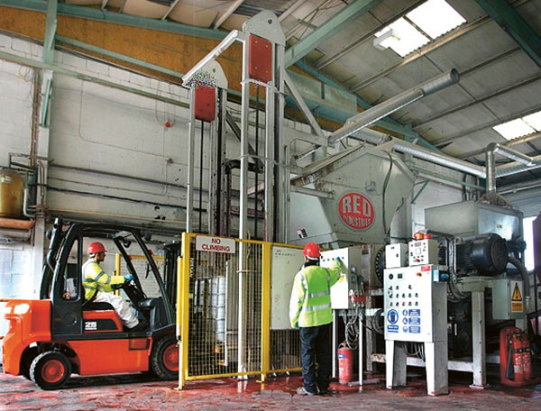
Red Industries

Slide 16
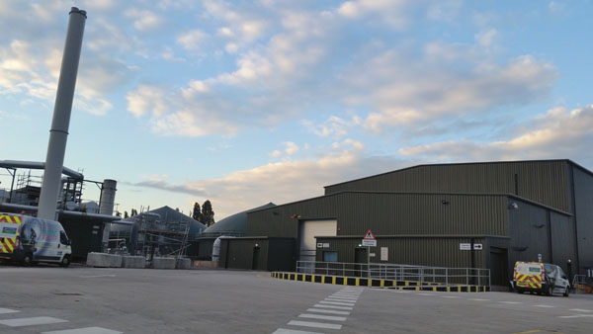
Severn Trent Coleshill Food Waste Plant

Slide 17
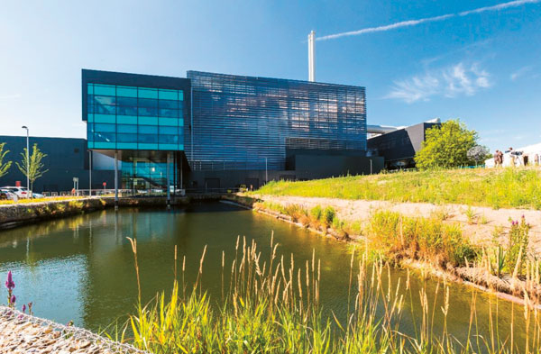
Suffolk Energy from Waste Facility - SUEZ

Slide 18
The winner is…

Slide 19
Suffolk Energy from Waste Facility - SUEZ

Slide 20
Highly commended
Red Industries
Severn Trent Coleshill Food Waste Plant

Slide 21
The Roger Hewitt Learning & Development Award

Slide 22
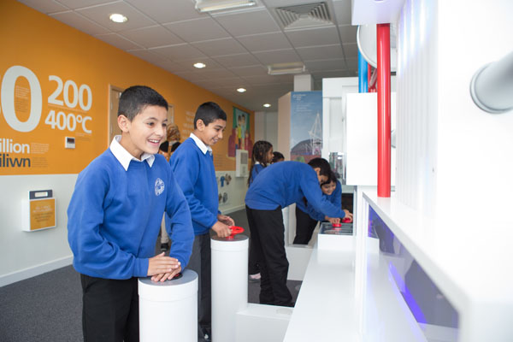
Education Team, Trident Park, Cardiff (Viridor)

Slide 23
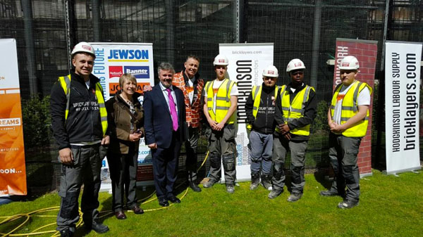
Milton Keynes College: Offender Learning

Slide 24
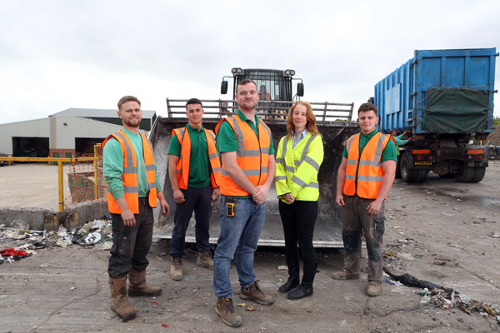
Sustainable Resource Management Team – Cambrian Training Company

Slide 25
The winner is…

Slide 26
Milton Keynes College: Offender Learning

Slide 27
Opensky Data Systems Award For Demonstrating Project Innovation

Slide 28
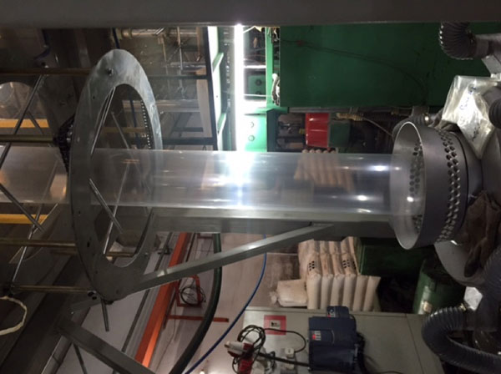
Aquapak Polymers Ltd

Slide 29
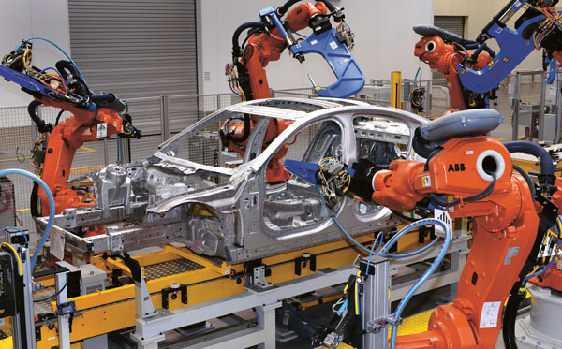
Jaguar Land Rover

Slide 30
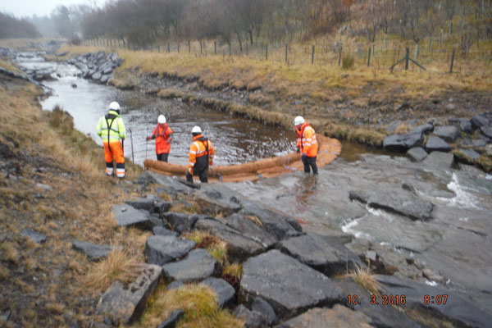
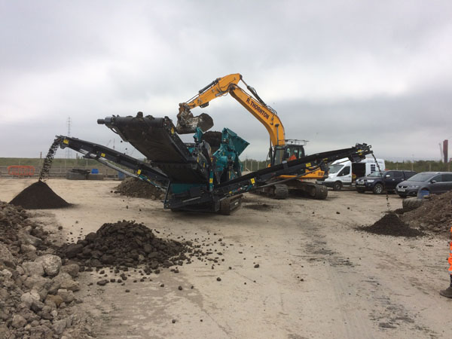
Ramboll Environ, Coal Authority & Environment Agency

Slide 31
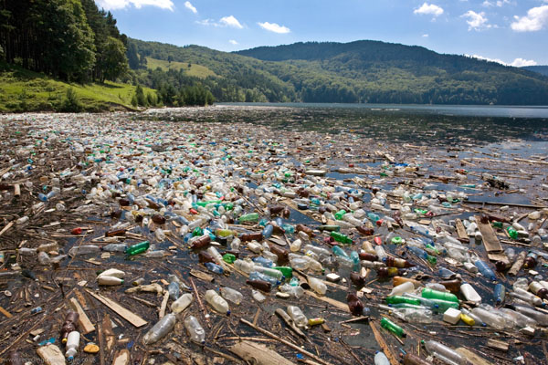
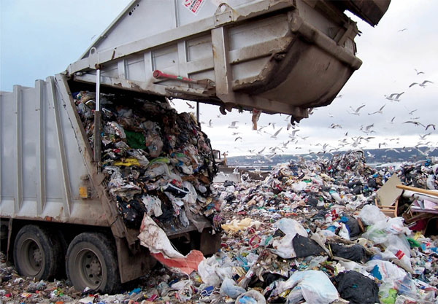
Recycling Technologies Ltd

Slide 32
The winner is…

Slide 33
Jaguar Land Rover

Slide 34
Hills Waste Solutions Best Recycling Project Award

Slide 35
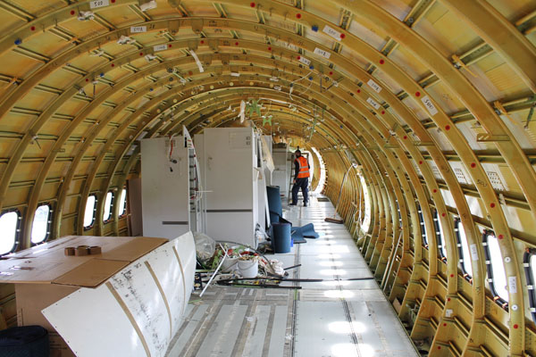
GJD Services Ltd

Slide 36
Jaguar Land Rover

Slide 37
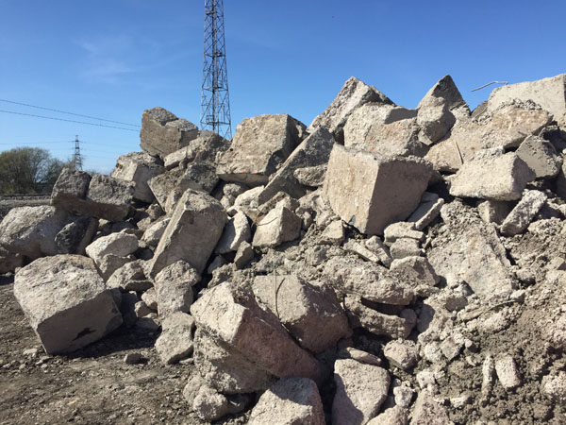
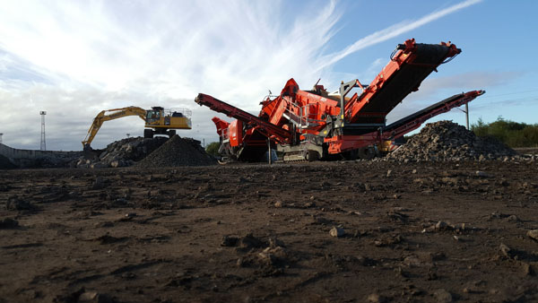
Network Rail Route Services, Supply Chain Operations

Slide 38
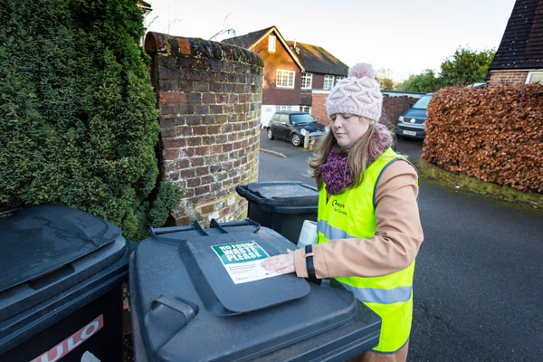
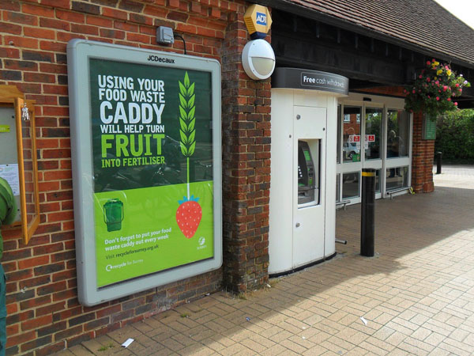
Surrey Waste Partnership

Slide 39
The winner is…

Slide 40
Network Rail Route Services, Supply Chain Operations

Slide 41
The Best Reuse & Waste Prevention Project Award

Slide 42
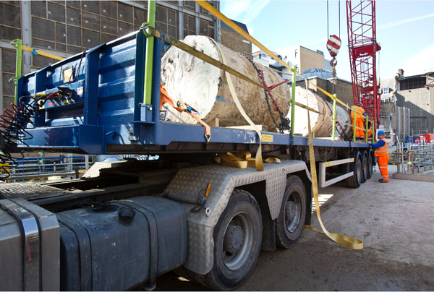
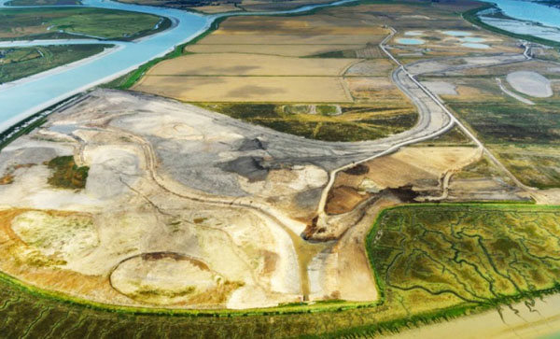
Costain Skanska JV C412 Bond Street Station (Crossrail)

Slide 43
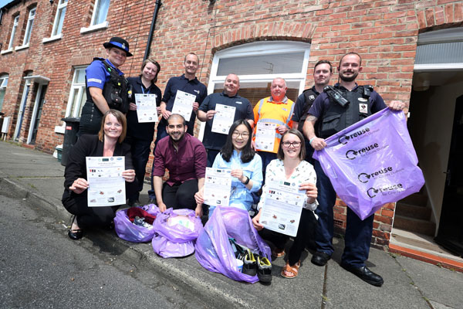
Green Move Out Campaign (Durham County Council)

Slide 44
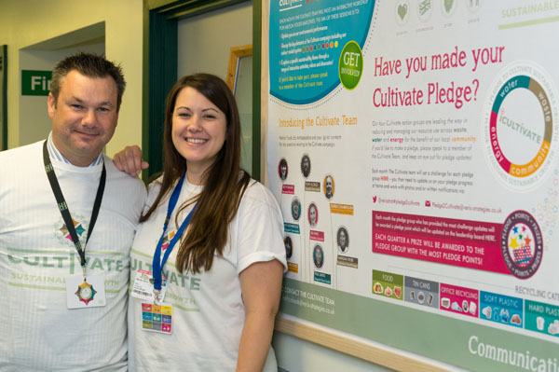
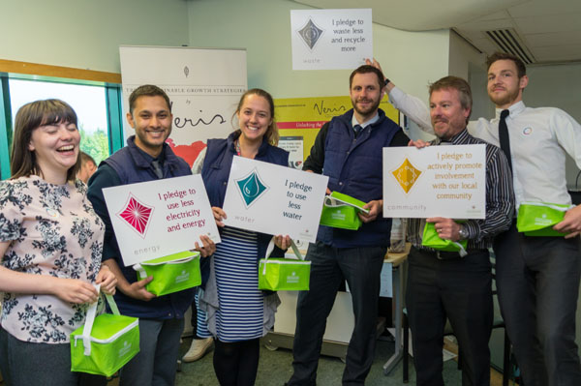
Melton Foods in Partnership with Veris Strategies

Slide 45
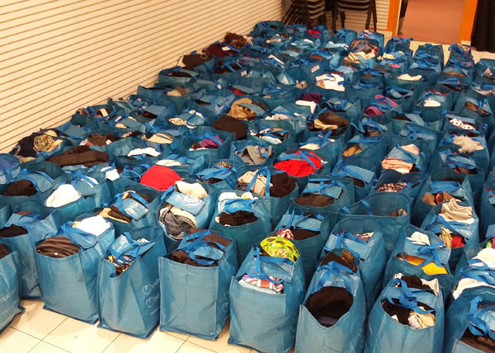
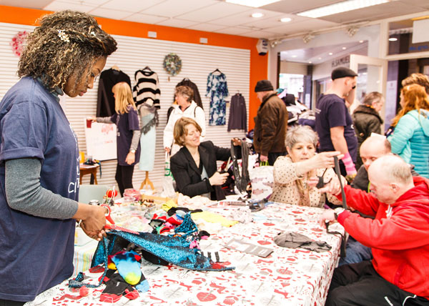
The Sustainability Lab – Bangor University

Slide 46
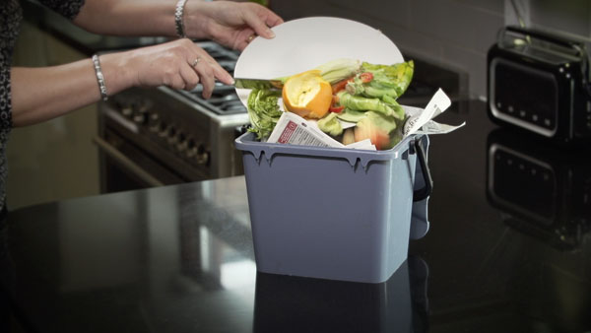
Warwickshire County Council

Slide 47
The winner is…

Slide 48
Costain Skanska JV C412 Bond Street Station (Crossrail)

Slide 49
Best Resources Project by Facilities Management Award

Slide 50
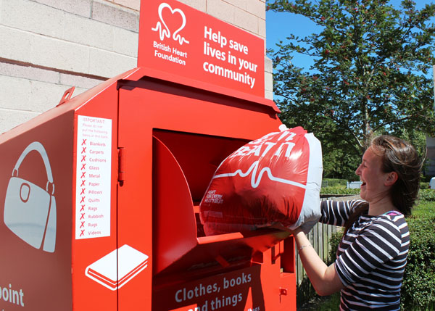
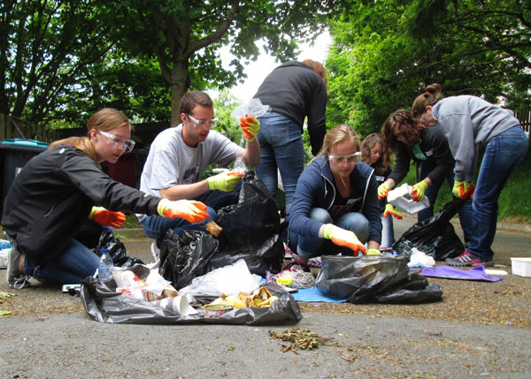
Bangor University #LoveHalls

Slide 51
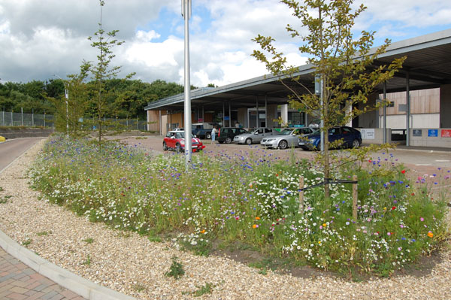
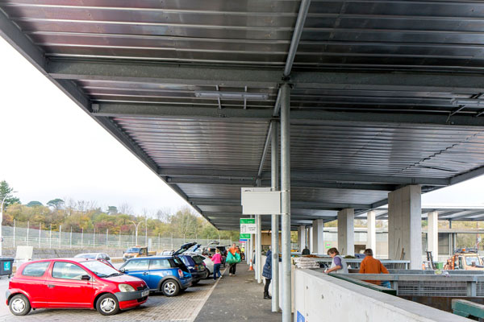
Bridport Household Recycling Centre: Dorset Waste Partnership

Slide 52
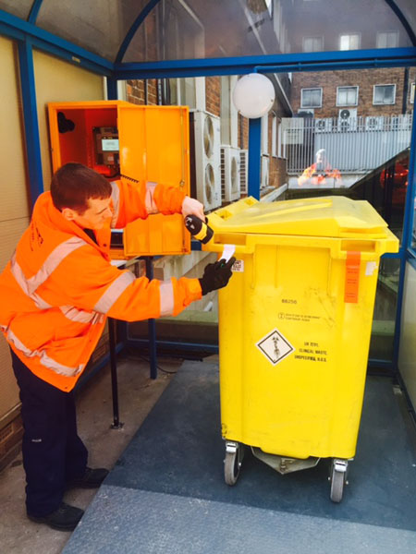
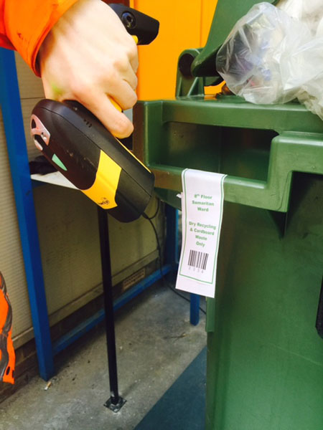
Guy’s and St Thomas’ NHS Foundation Trust with Bywaters

Slide 53
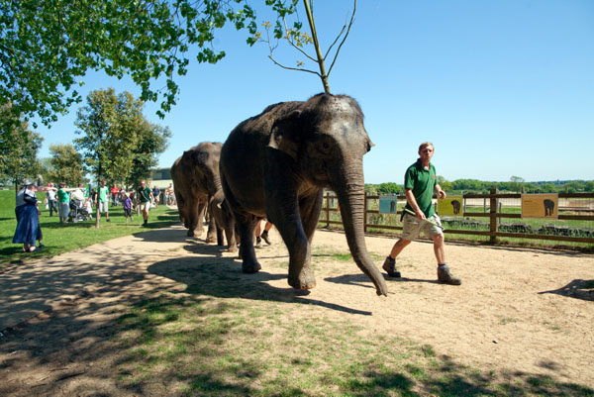
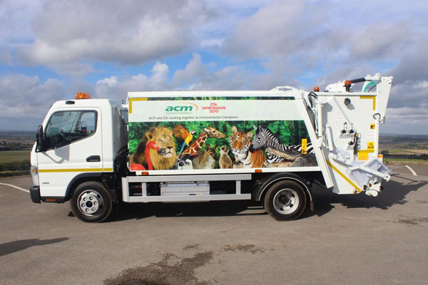
ZSL London and Whipsnade Zoo (in partnership with ACM Environmental Plc)

Slide 54
The winner is…

Slide 55
Bangor University #LoveHalls

Slide 56
Hako Machines Best Innovation in Vehicle, Plant & Equipment Award

Slide 57
airBOSS Wheel & Tyre Systems

Slide 58
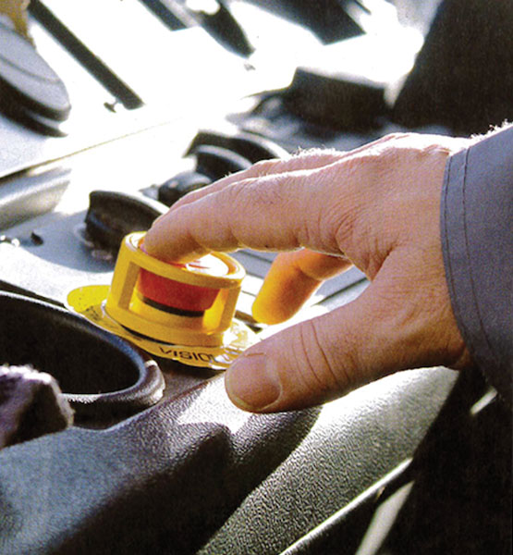
BrakeSafe – Vision Techniques

Slide 59
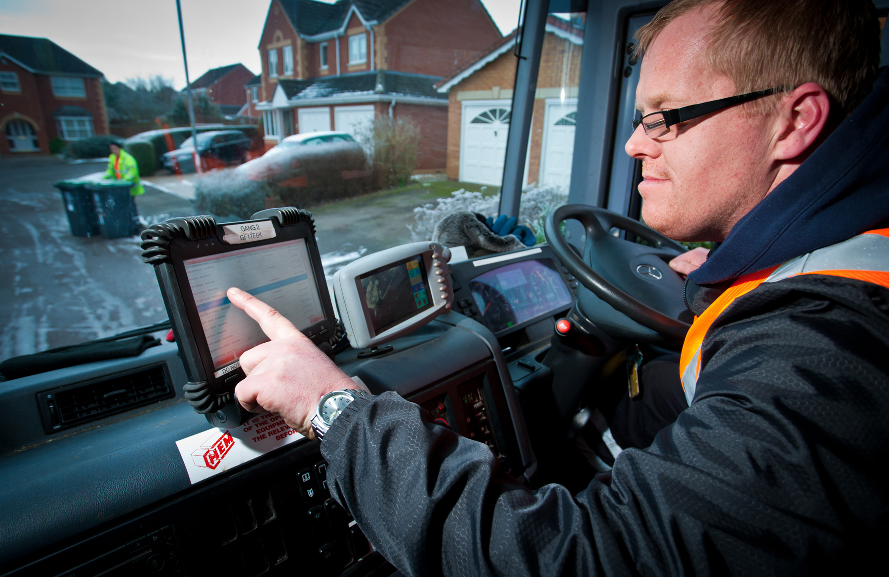
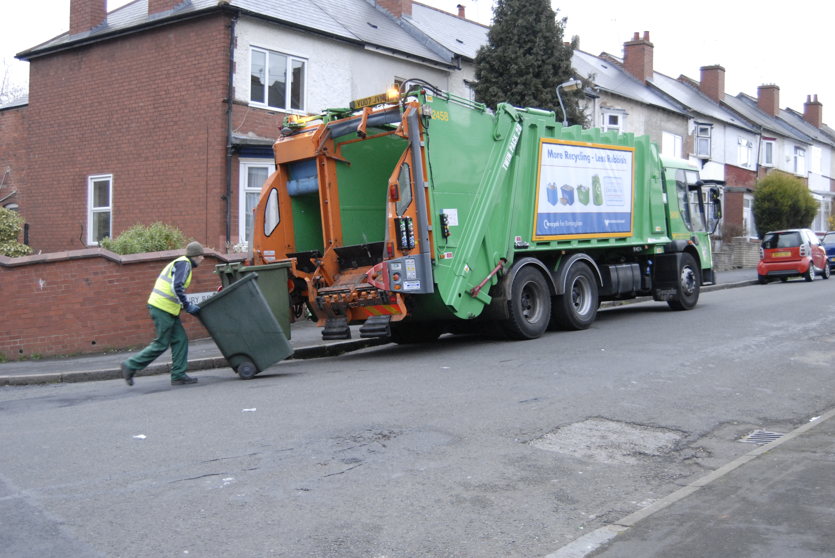
CMS SupaTrak

Slide 60
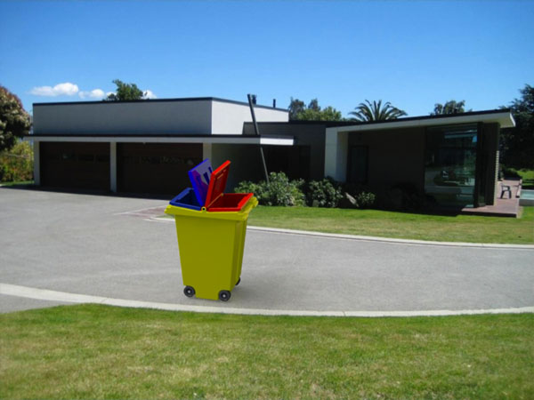
Mi-Bin

Slide 61
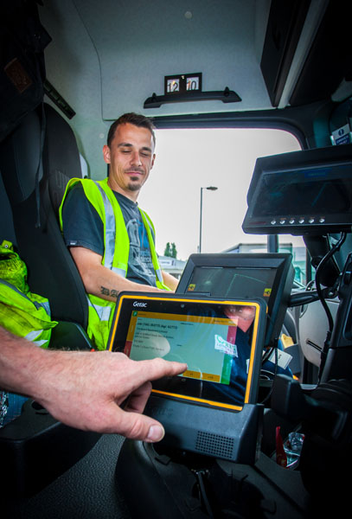
Vehicle Weighing Solutions & VWS Software Solutions

Slide 62
The winner is…

Slide 63
BrakeSafe –
Vision Techniques

Slide 64
NFDC Most Sustainable Construction & Demolition Project Award

Slide 65
McGee

Slide 66
Network Rail, Q Sustain and Mace

Slide 67
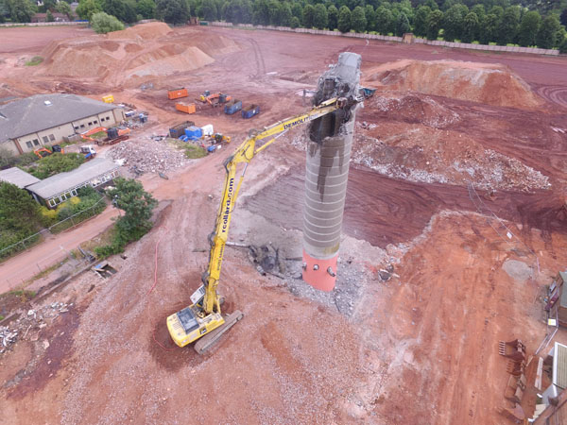
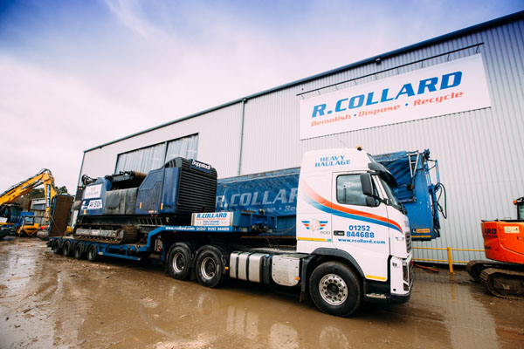
R Collard Ltd

Slide 68
Verde SW1 – Multiplex

Slide 69
The winner is…

Slide 70
Verde SW1 – Multiplex

Slide 71
Most Effective Communications Campaign Award

Slide 72
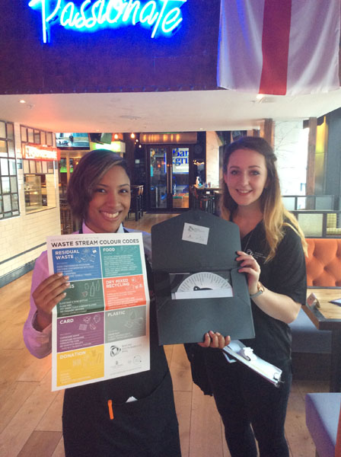
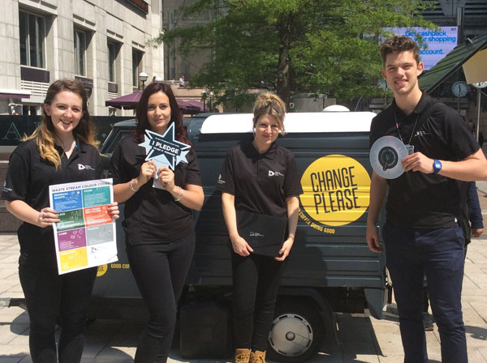
Canary Wharf Group Ltd with The Cawley Group

Slide 73
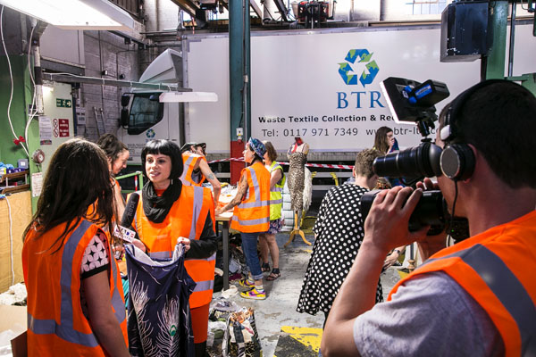
Love Your Clothes - WRAP

Slide 74
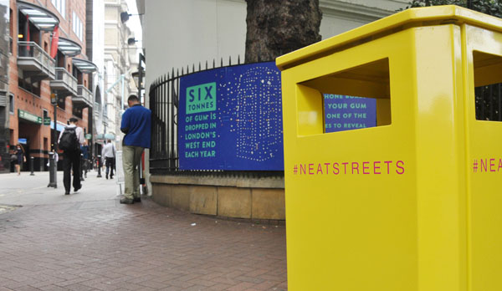
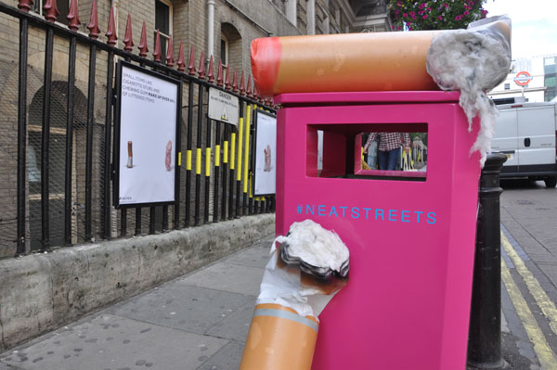
Neat Streets – Hubbub UK

Slide 75
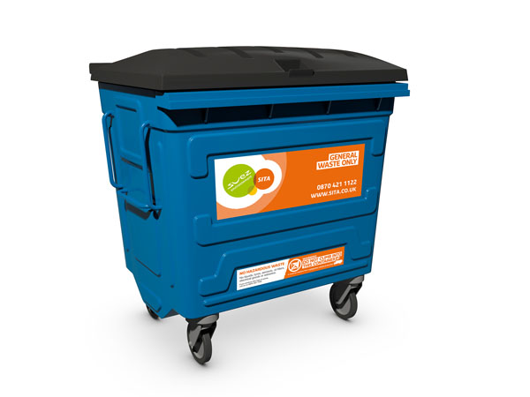
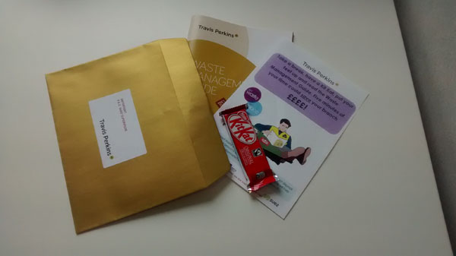
Travis Perkins Plc

Slide 76
The winner is…

Slide 77
Neat Streets – Hubbub UK

Slide 78
The ReFood Corporate Sustainability Business of the Year

Slide 79
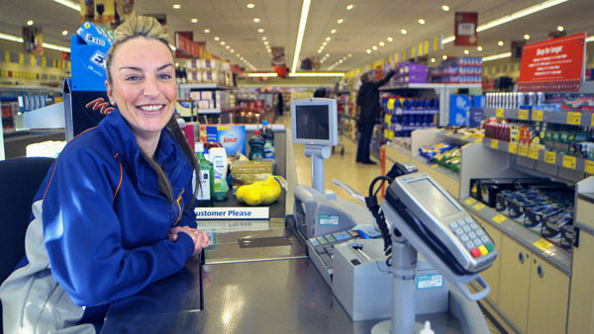
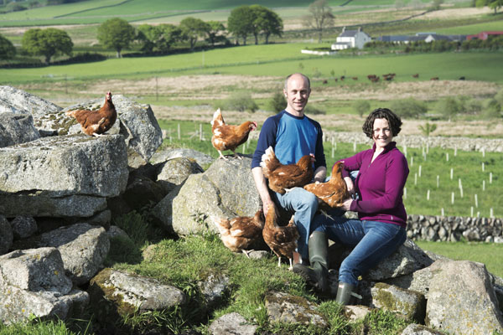
Aldi UK

Slide 80
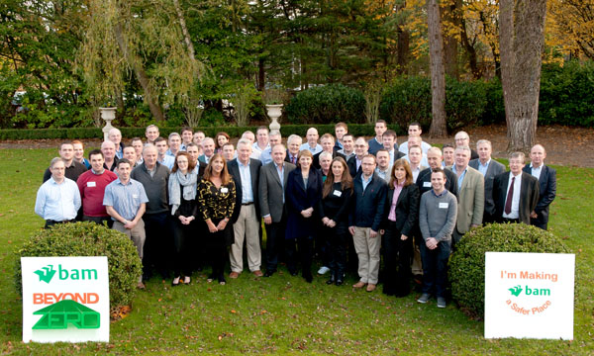
BAM Contractors

Slide 81
The winner is…

Slide 82
Aldi UK

Slide 83
GJF Fabrications Delivering Health & Safety Best Practice Award

Slide 84
Grundon Waste Management Ltd

Slide 85
South Staffordshire Council & Biffa Municipal Ltd

Slide 86
Waste & Recycling Service, Aberdeen City Council

Slide 87
Wastecycle

Slide 88
The winner is…

Slide 89
South Staffordshire Council
& Biffa Municipal Ltd

Slide 90
The Catalyst Corporate Finance Waste & Resources Fast 50 Award

Slide 91
Binn Group

Slide 92
Blue Machinery

Slide 93
First Mile

Slide 94
JBT Waste Services

Slide 95
Mick George

Slide 96
O’Donovan Waste Disposal

Slide 97
R Collard Ltd

Slide 98
Seneca Environmental Solutions

Slide 99
Simply Waste Solutions

Slide 100
Wilshee’s Waste & Recycling

Slide 101
The winner is…

Slide 102
Mick George

Slide 103
AMCS Group Industry Leader of the Year

Slide 104
Ray Georgeson MBE

Slide 105
Julie Hill MBE

Slide 106
Dominic Hogg

Slide 107
Lee Marshall

Slide 108
David Palmer-Jones

Slide 109
Sophie Thomas

Slide 110
The winner is…

Slide 111
Ray Georgeson MBE

Slide 112
Congratulations to all of today’s winners

Slide 114
Save the date:
Next year’s event will be on the 2 November 2017
To sponsor on these prestigious awards please contact Ginny Hunter on 01604 823346 or email ginny.hunter@ciwm.co.uk

