Slide 1
Improving Waste Management and Compliance
BNP Paribas 16th March 2017

Slide 2


Questions and discussion as we go
Introductions
Notes:
Introductions and housekeeping
Delegates to introduce themselves and indicate their experience with dealing with wastes
Tutor to introduce

Slide 3
Course Objectives
To appreciate the extent of UK legislation relating to wastes
To appreciate the key issues in relation to waste definition
To understand the practical implications of Duty of Care and related controls on wastes management
Be familiar with the Statutory Code of Practice
Know how to complete a Waste Transfer/Information Note

Slide 4
Course Objectives
To be aware of the essential elements of hazardous waste controls
To recognise the implications of environmental permitting controls to the recovery and disposal of waste
To gain an understanding of the essential elements of a range of waste controls including waste pre-treatment and WAC.
Understand the role of Auditing in helping to comply with your obligations
Provide opportunities for Discussion

Slide 5
Context of Waste Law and EC Influences

Slide 6
Overview
Policy – National and European
Pressure Groups/ Lobbying
European Directives and Regulations
National Acts of Parliament (Primary Legislation)
Regulations and Orders (Secondary legislation)
Circulars and Good Practice Guidance

Slide 7




Who are the Regulators

Slide 8
setting the scene for Duty of Care
Notes:
Brief session to discuss:
what waste is
Types of classification of wastes

Slide 9
Overview and background
W/B P3
Why do we have a ‘Duty of Care …… with respect to wastes management’?
Does Duty of Care work?
What might be the weaknesses of Duty of Care?
What influences behaviours?
Discuss
Notes:
Discuss the various bullet points briefly
Why do we have a ‘Duty of Care …… with respect to wastes management’?
Came in in 1992 to try and require anyone passing waste on to another to provide appropriate information so that the next party knew what the waste was and how to deal with it; Improve the management of wastes
Does it work?
If followed correctly the time the number of mistakes and illegal deposits would be dramatically reduced; the vast majority of waste producers and operators follow DoC (although waste producers often rely on the waste management companies); there remains illegal deposits and flytipping events:
Local authorities dealt with a total of 900 thousand incidents of fly-tipping in 2014/15, an increase of 5.6 per cent since 2013/14 with nearly two thirds of fly-tips involving household waste.
What might be the weaknesses?
Lack of information provided; rogue operators and businesses; illegal disposal usually cheaper than legal disposal (therefore not likely to follow DoC!); poor understanding of the wastes; incompetence
What influences behaviours?
Economics – colleagues – clients – types of wastes

Slide 10
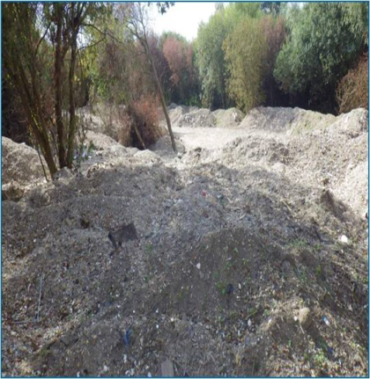
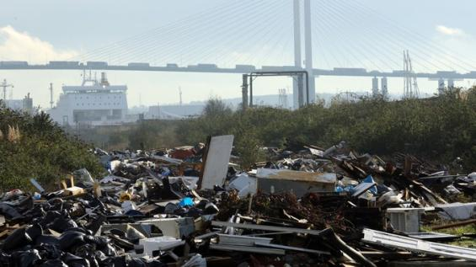
Has Duty of Care worked?

Slide 11
Duty of Care – who does it apply to?
That includes anyone who produces, carries, keeps or treats waste!!
(also brokers and dealers)
Everyone who handles waste
Who?
Employers are responsible for the ‘acts and omissions of their employees’
Notes:
House holders also now have a duty of care but this only requires them to pass their waste onto authorised persons
Employers are responsible for the ‘acts and omissions of their employees’ and this includes providing adequate training, supervision and equipment.
It applies to all Controlled waste = wastes controlled under the relevant uk regulations – household, commercial, industrial, non natural agricultural waste, mines and quarry waste. Doesn’t include radioactive wastes or explosives as these are covered under separate legislation.
Applies to UK only (not rest of EU) Northern Ireland only recently (2003) (regulations may be slightly different in Scotland/ NI but principles are the same.

Slide 12
The Waste Chain
W/B P4
Who is in the ‘chain’
Definitions – Holder, Broker, Dealer
What parts do they play
Key relationships
Who bears [most] responsibility
Self policing
When might by obligations end?
Notes:
Don’t go into huge detail – this is scene setting

Slide 13
Responsibility………..
Responsibility of defining waste
The person who produces it
Ensure that it causes no problems for the environment or human health
Notes:
Emphasising that it is the waste producer that has the legal responsibilities to manage their waste appropriately – and through DoC to ensure others further down the chain of waste management continue to manage appropriately.

Slide 14
Who is the waste ‘producer’?
‘Producer’ means
“ …anyone whose activities produce waste OR who carries out pre-processing, mixing or other operations resulting in a change in its nature or composition”
see Art 3 Waste framework directive (2008)
Consider - ‘original’ producer and ‘subsequent’ producer
Why is this important?

Slide 15
Management of Contractors
Who is the waste producer?
Where is the waste going?
Any potential risks or issues?

Slide 16
Duty of Care – General Principles
Control throughout waste chain
Recognising and managing hazards and risk
Having procedures & reviewing them
Recognising & taking responsibility
Record keeping
Monitoring and reporting
Legislative compliance
Notes:
Not just hazardous and non-hazardous wastes … some non-hazardous wastes have significant potential hazards or potential for nuisance (dusts / odours etc)

Slide 17
Duty of Care – the Expectation!
Recognise that you all have a role to
  Self police
  Preventing waste crime
  Being aware of your legal obligations
  ‘Directing’ what happens to waste
  Using ‘legitimate’ business
  Having systems in place to protect yourself, and
  Reporting suspected wrongdoing
  Right waste – Right Place – Right Person

Slide 18
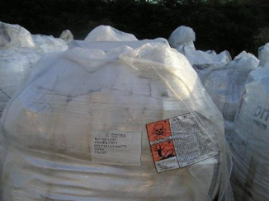
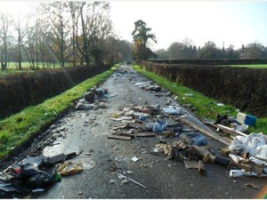
Could this be you? - Recent prosecutions
Two companies have been fined a total of £26,000 following an Environment Agency investigation into the illegal handling, storage and export of hazardous waste.
Huge piles of waste were strewn across
a country road and traced to a builder
who had used unregistered carrier to
dispose of waste one .

Slide 19
Code of Practice
W/B P7
Has details on how to comply
Can be used in court
Notes:
Ensure code of practice is explained – show latest version, explain that duty of care has been reviewed (2011) and the COP has also been recently consulted upon.
http://www.defra.gov.uk/environment/waste/legislation/pdf/waste_man_duty_code.pdf
New code of practice (to be) issued in 2016?
Consultation
Updated
No fundamental changes
focus on waste producer
Includes Carriers and Brokers
Links to new WFD issues
Best practice
Consider further later in course
Provide a copy of the consultation version CoP and briefly discuss/refer to as proceeding through this section.

Slide 20
Duty of Care
Legislation

Slide 21
Legislation roadmap – England & Wales
Waste (E&W)
Amend Regs
2014
Defn of Waste
(Guidance 2012
- part 2 updated 2016 )
Controlled Waste
(2012 Regs)
Waste (E&W)
Regs 2011
Duty of Care
Registration of
Carriers/Brokers
EPA 90
Sections 33 & 34
Environmental
Permitting Regs
2016
Code of
Practice
2016
Household
Waste regs
2005
Public
Registers
Hazardous
Waste
(2005 & 2015
Regs)
Industrial Emissions Directive (2013)
NB: Scotland & Northern Ireland - Separate legislation
Notes:
Still applies to Wales
Scotland and NI have DoC but some slight changes - such as code of practice already issued. See next slide
Also mention that the CNEA brought in fixed penalty notices for some duty of care offences

Slide 22
Definition of Waste
Meaning of “Discard”
In legislation – courts decide
Guidance with some examples
Types of waste – Controlled waste H,C,I
Prevent waste
Cease to be waste

Slide 23
When wastes cease to be wastes
End of waste test
    Environment Agency - ‘IsItWaste’ tool
      End of waste or By-product
Construction industry definition of waste COP
Use and compliance with Quality Protocols (QP), examples include
    Aggregates (from inert waste)
    Compost (PAS 100)
    Reuse of WEEE (PAS 141)
Notes:
Isit waste tool
self-assessment tool to help you decide whether your material is likely to be a waste or not.
The tool is based on the By-Products (Article 5) and End of Waste (Article 6) parts of the Waste Framework Directive (Waste Framework Directive 2008/98/EC ).
Generally quality protocols:
ensure the product made from waste does not pose an unacceptable risk to human health or the environment
increase market confidence in the quality of products made from waste and their potential value
encourage greater waste recycling and recovery

Slide 24
The ‘Glue’!
Environmental Permitting Regs 2016
Waste E&W Regs 2011/2014
Exports
Carrier, Broker Dealer
EPA90
Section 33 Section 34
Duty of Care 2011
Public Registers
Haz waste regs 2005 & 2015
Code of Practice 2016
Notes:
The Waste (England and Wales) Regulations 2011 (amended 2014) repealed the Environmental Protection (Duty of Care) Regulations 1991 and apply the Duty of Care requirements brought in by the Environmental Protection Act 1990.
Introduced the requirement for the waste hierarchy; new controls for waste carriers and the registration system; requirements on a transfer note
The 2014 amendment regs – relevant offences for revocation of registration; permits the use of alternative documentation to the Waste Transfer Note such as invoices or even email. But the legal requirements for what must be included remain the same.
Also there are the following (not included in slide)
The Household 2005 regs inserted the following into s34 of EPA90:
“(2A) It shall be the duty of the occupier of any domestic property in England to take all such measures available to him as are reasonable in the circumstances to secure that any transfer by him of household waste produced on the property is only to an authorised person or to a person for authorised transport purposes.”
Seizure regs
These Regulations provide for how seized property must be dealt with in England and Wales, where property is seized under section 5 of the Control of Pollution (Amendment) Act 1989 (c. 14) (power to require production of authority, stop and search etc.) or section 34B of the Environmental Protection Act 1990 (c. 43) (power to search and seize vehicles etc.). The Environment Agency, the Natural Resources Body for Wales and a waste collection authority (“a seizure authority”) can seize property under these powers.

Slide 25
Waste Framework Directive – Relevant Objectives
Article 13 of the WFD
Member States shall take the necessary measures to ensure that waste management is carried out without endangering human health, without harming the environment and, in particular:
a) without risk to water, air, soil, plants or animals
b) without causing a nuisance through noise or odours; and
c) without adversely affecting the countryside or places of special interest.
Note: this is important when we come to Exemptions

Slide 26
Legislation E&W
Environmental Protection Act 1990
section 33 & section 34
Waste (E&W) Regulations 2011
  Waste hierarchy
  Carriers & Brokers & Dealers
Environmental permitting regulations 2016
  Permits, conditions and Exemptions

Slide 27
Section 34 (1) of EPA90 - Obligations on ALL holders of waste
Prevent any contravention by any other person of s33
Prevent the escape of waste from his control or that of any other person
Transfer only to an ‘Authorised person’
To ensure [adequate] written description of the waste on transfer
Notes:
Prevent any contravention by any other person of s33
i.e. To prevent any contravention by any other person of regulation 12 of the Environmental Permitting Regulations 2010 or of a condition of a permit granted under those Regulations
Each one of these will be discussed in more detail as we go through the course.

Slide 28
Waste (E&W) Regulations 2011-1
  Implemented the revised WFD
  Replaced Duty of Care regs 1991
  Sept 2011 waste hierarchy
  Jan 2015 separate collection
  Replaced Carrier & Broker regime
    (additional requirements Dec 2013)
  Amended hazardous waste regs

Slide 29
Waste (E&W) Regulations 2011 - 2
Regulation 12:
  ‘Apply the waste hierarchy in priority order’
Also:
  Required separate collection of [segregated] wastes (from Jan 2015)
  Prohibits mixing of [segregated] wastes
  Guidance on above (TEEP etc)
Notes:
TEEP - technically, environmentally and economically practicable

Slide 30
Waste Hierarchy - activity
?
?
?
?
?
Notes:
Flip Chart – triangle
Groups to consider what the 5 sections of the hierarchy are – NO PEAKING IN NOTES!!!!!
Also consider what each section covers (description and examples)
Time may be saved by splitting in 5 groups and giving each group a section eg top , bottom etc.
Then collectively complete hierarchy on flipchart.
Alternatively ask delegates to identify what type of waste management activity could be an option for the following wastes and where each would fit into the hierarchy:
Computer, cardboard packaging, glass waste, waste oil, scrap metal components, residual waste

Slide 31
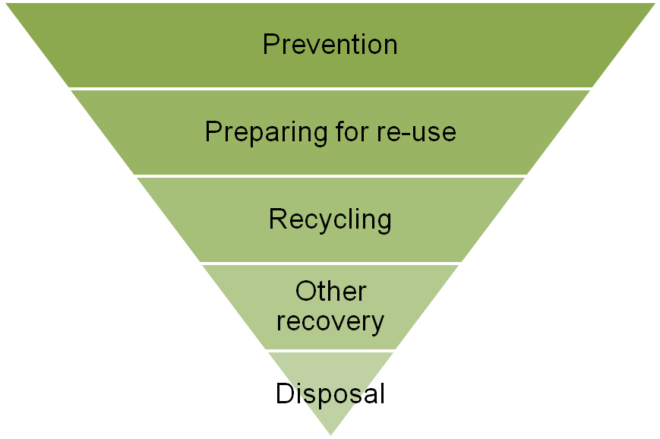
Waste Hierarchy and Duty of Care
W/B P12
Priority
Increasing risk
of illegal activity

Slide 32
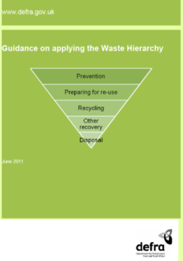
Waste Hierarchy
W/B P12
Self-policing
Enforcement
Illegal waste management

Slide 33
Waste Amendment Regulations 2014
April 6 2014 slight amendment to:
Added more ‘prescribed offences’
Allowed other forms of ‘waste information’ (and encourage Edoc)
Copy registration certificates, and
Clarified production of proof of registration and enforcement authorities

Slide 34
Written Description and coding
W/B P14
Issues
Descriptions “Factory rubbish!” “Skip waste”
List of Waste code
Segregation of wastes
Further information e.g. testing and analysis
Landfill requirements i.e. WAC
Pre-treatment
Waste Hierarchy compliance

Slide 35
EU ‘List of Waste’ codes
(European Waste Catalogue)
Notes:
The EWC has been referred to as the List of Waste (LoW) code in England and Wales since 2005. Although the List of Waste Regulations have now been revoked many guidance documents and organisations continue to refer to the List of Wastes code.

Slide 36
European Waste Catalogue
There is a legal requirement to determine the List of Waste (EWC) code(s) of waste for:
  Duty of Care
  Assess Hazardous waste
  Environmental permit and exemption acceptance
  Landfilling wastes (basic characterisation)
  Operator returns
  Landfill tax
  Waste statistics
Notes:
Talk through this example first so group understand what a 6 digit code is.
Then next stage will be to ensure they understand the protocol

Slide 37
What is the List of Waste?
Consists of 20 chapters
  Sources of waste:
    Chapters 1 - 12
    Chapter 17 - 20
  Waste type
    Chapters 13, 14 and 15
  Waste not covered elsewhere
    Chapter 16
Revised version from June 2015
Notes:
June 20-15 revision include reference to hazardous substances
The three new entries from June 2015 are:
010310* red mud from alumina production … (which required a change to 010309)
160307* metallic mercury
190308* partly stabilised mercury (required change to 190304*)

Slide 38
What is the List of Waste?
W/B P15
3 elements to code
  chapter heading
    E.g. 04 Wastes from Leather, fur and textile industries
  Sub chapters – further define waste
    04 02 Wastes from textile industry
  List of wastes
    04 02 10 – Organic matter from natural products (e.g. Grease and wax)
Notes:
Although this slide will be in the handouts – ask delegates to refer to the chapter 4 and look at the codes and structure of the list
Use the chapter 4 EWC code for grease to indicate the holistic nature of the list ... In that this code is not appropriate for any grease waste … only a grease from the textile industry

Slide 39
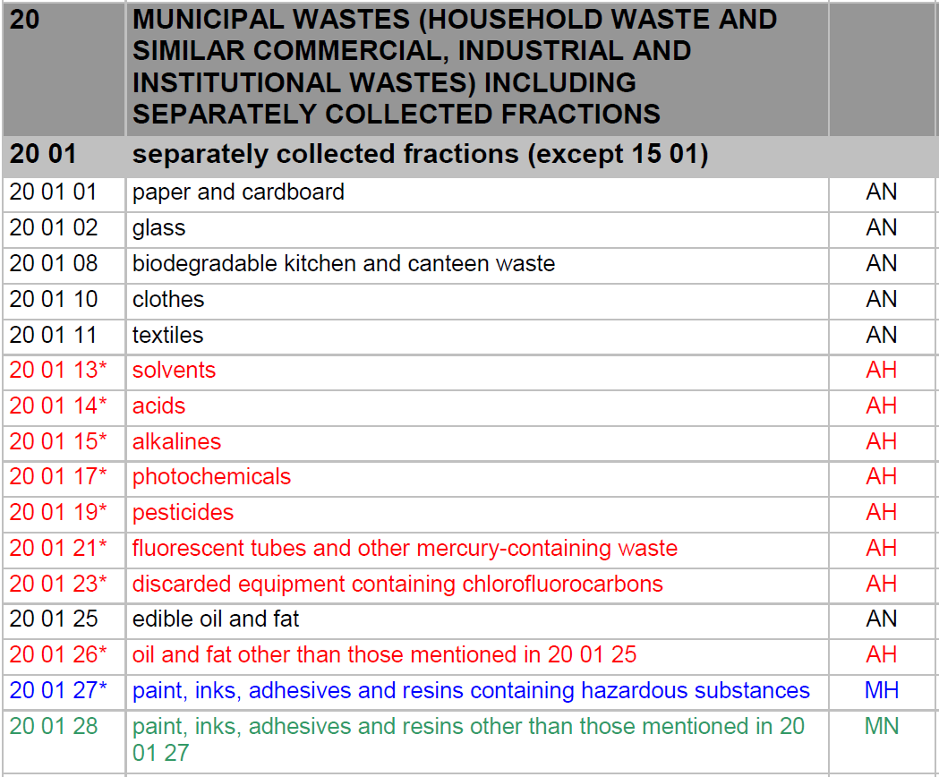
Notes:
Not in slide handouts as delegates can refer directly to the lists provided
This sub-chapter is used as it highlights all the different types of codes.
The meaning of AN, AH, MH and MN
The fact the list now refers to ‘hazardous substances’ and not dangerous substances
The fact that some mirror entries are linked entries to one or more other entries.
Refer to the ‘99’ code
The following slides re-iterate the types of codes

Slide 40
Absolute hazardous entries
Within each subchapter are the individual 6 digit waste codes - those marked with an asterisk (*) are Hazardous Waste
Some wastes are considered to always be hazardous – referred to as ‘absolute’ hazardous entries
  13 07 01* fuel oil and diesel AH
  It does not matter what types or levels of chemicals are present - the waste is always hazardous
Notes:
Other common examples include fluorescent tubes (200121*) and lead acid batteries (160601*)

Slide 41

Absolute non-hazardous entries
For entries that are not absolute hazardous or part of a mirror pair or set of entries – these are non-hazardous entries.
  e.g. 15 01 01 ‘paper and
  Cardboard packaging’

Slide 42
Mirror entries
Some wastes have the potential to be hazardous OR non-hazardous depending on whether they contain hazardous substances and the amount of hazardous substances that are contained
These are covered by two or more linked or ‘mirror’ entries
17 05 03* soil and stones containing Hazardous
substances MH
17 05 04 soil and stones other than those mentioned in 17 05 03 MN

Slide 43
Identification by waste source
Chapters 1 to 12 or Chapters 17 to 20 (not 99 codes)
Remember – more than one code can be used to classify a waste
Identification by waste type
Chapters 13 to 15
Other general wastes -Chapter 16
Non-specific wastes - if no applicable codes, then use the ‘99’ code from the most appropriate chapter 1 to 12 or 17 to 20
Notes:
Slide to come in in order.
Use an example to highlight the more than one code can be used – e.g. skip full of separate fractions of concrete, plasterboard, wood.

Slide 44
EWC Exercises (A)
Waste iron and steel from the demolition of a building
Cardboard packaging – collected from a supermarket
Out of specification whisky from a distillery
Pallet of (ex forklift) lead-acid batteries from warehouse
Waste collected from a small newsagent – consisting of paper, plastic, out of date food items, cans etc
Used cooking oil collected from a restaurant
Small fridge from works canteen
Oil contaminated rags and wipes from your site
Paint tins from office decoration (residues remain in tins)
Used engine oil
Used bait boxes
Soil contaminated with Japanese knotweed
Notes:
Exercise –
Split into groups
Groups to identify the EWC codes for the following wastes:
Waste iron and steel from the demolition of a building – 17 04 05
Waste medicines from a health centre – non cancer treatment = 18 01 09
Cardboard packaging – collected from a supermarket = 15 01 01
Out of specification whisky bottles from distillery = 02 07 02 or 02 07 04
Waste synthetic hydraulic oils from a heavy plant maintenance company = 13 01 11
Pallet of (ex forklift) lead-acid batteries from warehouse = 16 06 01*
Old broken metal gates from land owned by the Forestry Commission = 02 01 07 (or 02 01 10)
Waste collected from a small newsagent – consisting of paper, plastic, out of date food items, cans etc = 20 03 01
Used cooking oil collected from a restaurant = 20 01 25
Flytipped domestic fridge = 20 01 23 (discarded equipment containing chlorofluorocarbons), if refrigeration equipment transferred to a WEEE collector than may need to use 16 02 11 ?

Slide 45

Waste Electrical and Electronic Equipment (WEEE)
What
Why
Who

Slide 46
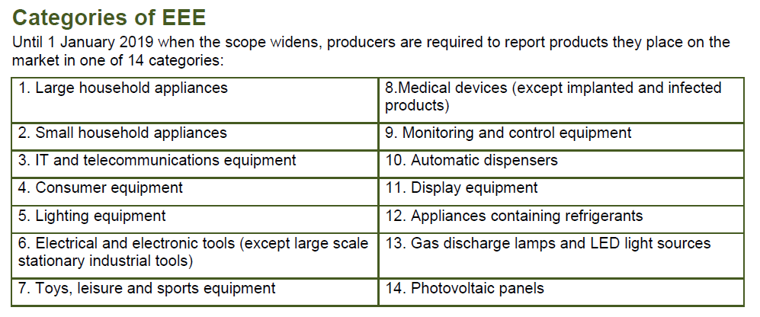
WEEE

Slide 47
Duty of Care
Obligations

Slide 48
Duty of Care Obligations
Prevent contravention of S33
(EPA 1990)

Slide 49
Objectives of section 33
A person shall NOT
(a) deposit controlled waste or extractive waste, or knowingly cause or knowingly permit controlled waste or extractive waste to be deposited in or on any land unless an environmental permit authorising the deposit is in force and the deposit is in accordance with the permit
(b) submit controlled waste, or knowingly cause or knowingly permit controlled waste to be submitted, to any listed operation (other than an operation within subsection (1)(a)) that
  is carried out in or on any land, or by means of any mobile plant,
  and is not carried out under and in accordance with an environmental permit.
(c) treat, keep or dispose … in a manner likely to cause pollution of the environment OR harm to human health

Slide 50
Section 33 … in other words
Keeping, treating, deposit and disposal of waste requires an “environmental permit”
A person shall not keep waste in a manner likely to cause pollution or harm to human health
‘A person shall NOT …knowingly cause or knowingly permit…’
Notes:
Enforcement of permit conditions enforced through Environmental Permitting Regs
Full wording of S33 (1)
A person shall NOT
(a) deposit controlled waste, or knowingly cause or knowingly permit …on any land unless an Environmental Permit authorising the deposit is in force…
(b) Submit controlled waste or knowingly cause or knowingly permit controlled waste to be submitted to any listed operation…
In or on land or by mobile plant, and
Is not in carried out under and in accordance with an environmental permit
(c) treat, keep or dispose … in a manner likely to cause pollution of the environment OR harm to human health

Slide 51
Prevent Contravention of s33 of the EPA 1990
  Prevent unauthorised or harmful deposit, treatment or disposal
  Prevent a breach of an environmental permit, or a breach of a permit condition
  If you suspect that someone:
    is illegally depositing, treating or disposing of waste
    does not have an appropriate permit or exemption, or that they are breaching a condition of their permit or exemption
  do not give your waste to them or take waste from them
Notes:
Wording from consultation CoP
Examples of unauthorised or harmful deposit, treatment or disposal include the following:
• operating illegal waste sites without the correct permit or exemption to accept or manage a particular waste
• fly-tipping, the deliberate unlawful dumping of waste eg at the roadside or on privately owned land. The scale can vary from a single bin bag of waste to large quantities of waste dumped from trucks
• importing or exporting waste to other countries without applying the correct controls or in a manner that is prohibited
Examples of activity that would breach a permit condition include the transfer of waste:
• to a facility that does not have an appropriate permit to accept or manage that type of waste
• in a condition which means that it cannot be managed or stored safely pending removal
• in a quantity that causes a facility to exceed the limits allowed by its permit or exemption

Slide 52
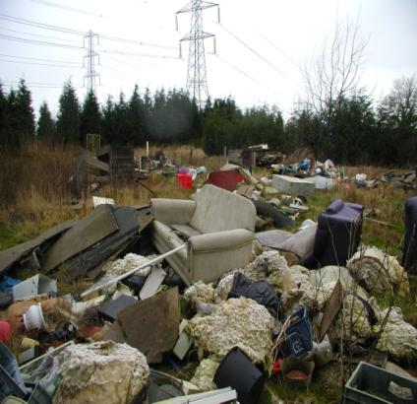
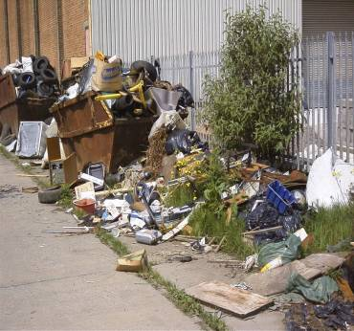
Deposit without a permit

Slide 53
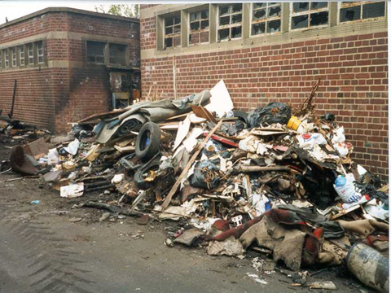
Flytipping – what & why?
Illegal deposit of waste on land
Offences 33(1)(a) & from motor vehicle
Causes – cost, laziness, lack of facilities
Undermines legitimate business
Costs to LA’s and land owners of clean up
Seizure of vehicles (2015)

Slide 54
Prevent Contravention of s33 of the EPA 1990
W/B P21
?
How do you prevent contravention by any other person of s33 of the EPA 1990?
What evidence do you need to determine compliance with this obligation?
Notes:
Quick delegate conversation and interactive discussion
Have you seen an environmental permit for the facility accepting your waste?
Check the permit authorises the waste type and quantity
Does the operator comply with their permit conditions?
Is the waste operator storing their wastes correctly?
Have you given the correct information about the waste
Is it adequate for others handling the waste to know what it is and how to handle it?
Duty of care audit on waste facilities
Consider advice the Code of Practice gives
Keep records

Slide 55
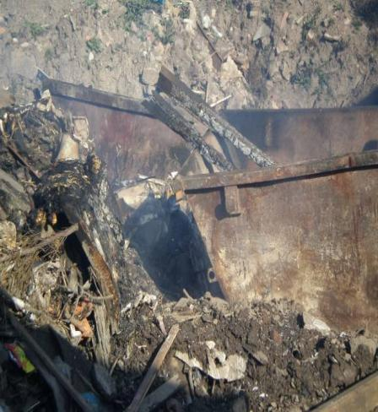
Permits and Conditions
W/B P22
What kind of permit?
What conditions might apply?
How can I tell if conditions are being complied with?
What should I be looking for?
Notes:
Note – exemptions / Regulatory position statements / low risk waste position statements

Slide 56
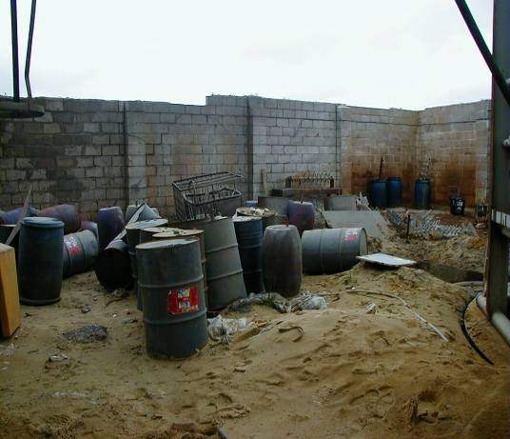
Activity – your thoughts?
Notes:
If the delegates witnessed the storage of waste at these sites … would you use them?
If you did are you complying with your duty of care?
Are these wastes being stored in a manner that may cause pollution to the environment or harm to human health?

Slide 57
Recent prosecution example
The company responsible had failed to manage and operate its waste oil treatment site under the terms of its permit.
Fined a total of £30,000 and ordered to pay full costs of £6,569 as well as a victim surcharge of £120.
The pollution in July 2012 cost the company’s insurers £169,000 to clean up.
http://www.bbc.co.uk/news/uk-england-suffolk-26843229
Notes:
Please see accompanying information in file named: ‘Oil from a waste treatment plant in Ipswich polluted River Orwell’
This file containers two separate reports on the event and prosecution.

Slide 58
Duty of Care Obligations
Prevent Escape of Waste

Slide 59
Prevent Escape of waste
Producers bear the main responsibility for packing waste to prevent its escape in transit
A Carrier is responsible for the adequacy of packaging whilst under his control - he should not rely totally on how it is packed or handed over by the previous holder
A Broker/Dealer also has obligations
escape also happens at waste management/disposal sites

Slide 60
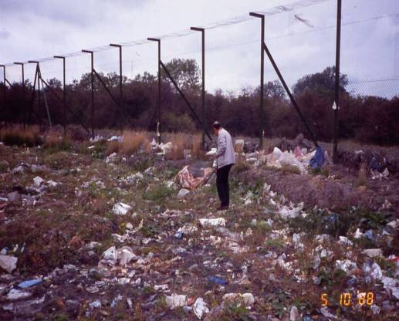
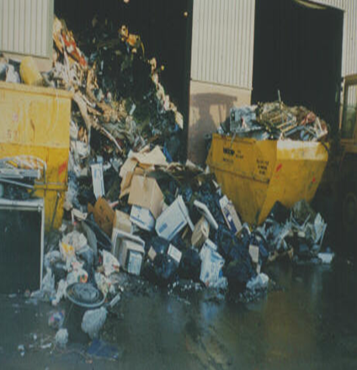
Examples of Escape

Slide 61
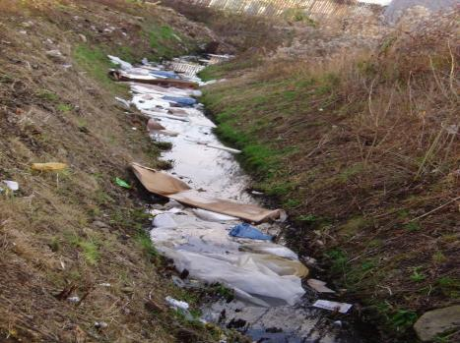
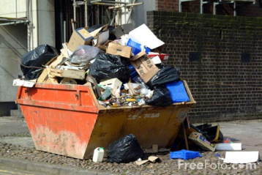
Wind blown litter from a waste facility
Over loaded skip?
Notes:
As well as a potential breach of permit and an unauthorised water discharge activity, it would also be a duty of care offence – therefore 3 offences for the regulator to consider
Windblown litter from a waste permitted facility – collecting in a drainage ditch outside of the facility
Ask the question – who is potentially responsible?

Slide 62
Keeping waste safely: additional guidance
Duty for each holder to ensure against:
Corrosion of containers
Spillage/leaks/leaching from rainfall
Accidents/weather causing damage to containers
Wind blown waste
Vandals, thieves, children, trespassers, animals
Correct labelling and storage of waste
Notes:
Shows how the ‘current’ ACOP provides guidance on this duty
The new code of practice also

Slide 63
Duty of Care Obligations
Transfer to Authorised Person

Slide 64
Transfer waste only to an ‘Authorised person’
Authorised persons are:
A Registered Carrier
  Lower and Upper tier carriers
  Brokers and Dealers in waste
Holder of an appropriate Environmental Permit or an Exemption

Slide 65
Carrier / Broker / Dealer Registration
Must register as a waste carrier, broker or dealer if you do any of the following as part of your business:
  Transport your own waste (lower tier except C&D wastes)
  Transport or dispose of waste for someone else
  Buy or sell waste
  Act as a waste broker (arrange for someone to handle other people’s waste)
Notes:
Requirements for registration of carriers have been amended in England and Wales by the Waste (England and Wales) Regulations 2011.
Specified individuals = lower tier = one off registration. These include:
A charity, voluntary org, WCA, WDA, WRA, someone who carries/ deals only in animal by-products; mine/ quarry waste or from agricultural premises, carriers of own waste (non C&D).
Registration for lower tier = free
Carriers of construction or demolition waste (or allied to) MUST be registered even though they may be carrying their own waste
What might be in such skips?
How can such waste be described or possible hazards assessed?
All others must register every 3 years. (upper tier)
Last for 3 years
Current prices = £154 (renewal = £105 and cost of registering as broker if you are already a carrier = £40)
If using contracted carriers / sub contractors you must see their registration certificates – not a photocopy
Only employees are covered under your carrier registration – not sub contractors
You can be fined up to £5,000 if you don’t register

Slide 66
Carrier Registration
Carrier Registration Certificate
  Depending on where the contractors main place of business is:
    England, Wales, Scotland, Northern Ireland
Registration lasts 3 years
Fee for renewal (upper tier)
Can check on Public register
  ‘new’ register
Notes:
Show registration certificate
Certificate has an embossed silver label – difficult to illegally copy them
Where possible and if time use internet connection and search the public register for a waste contractor

Slide 67
Public Registers
See
https://www.gov.uk/topic/environmental-management/environmental-permits
https://www.gov.uk/government/publications/low-risk-waste-activities-guidance

Slide 68
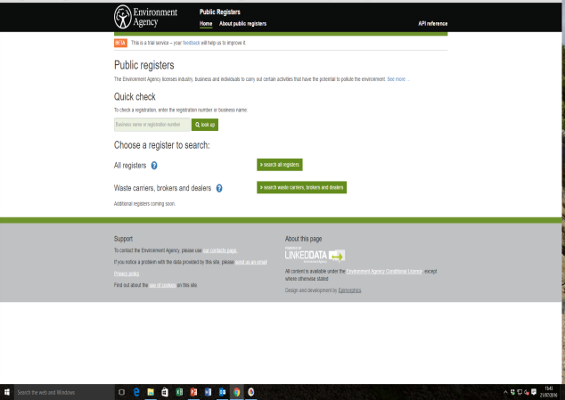
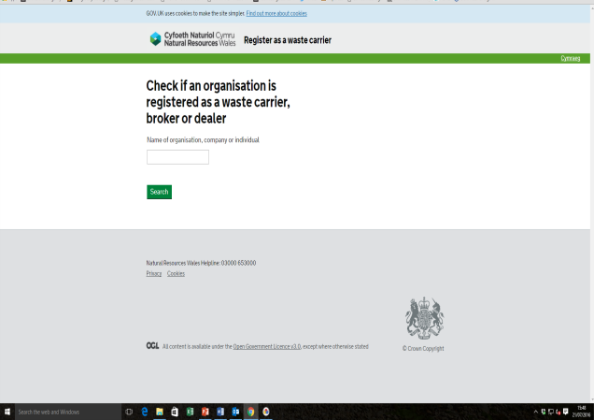
Public Register
England
Wales
Notes:
If internet access and time allowing then will show these on internet.

Slide 69
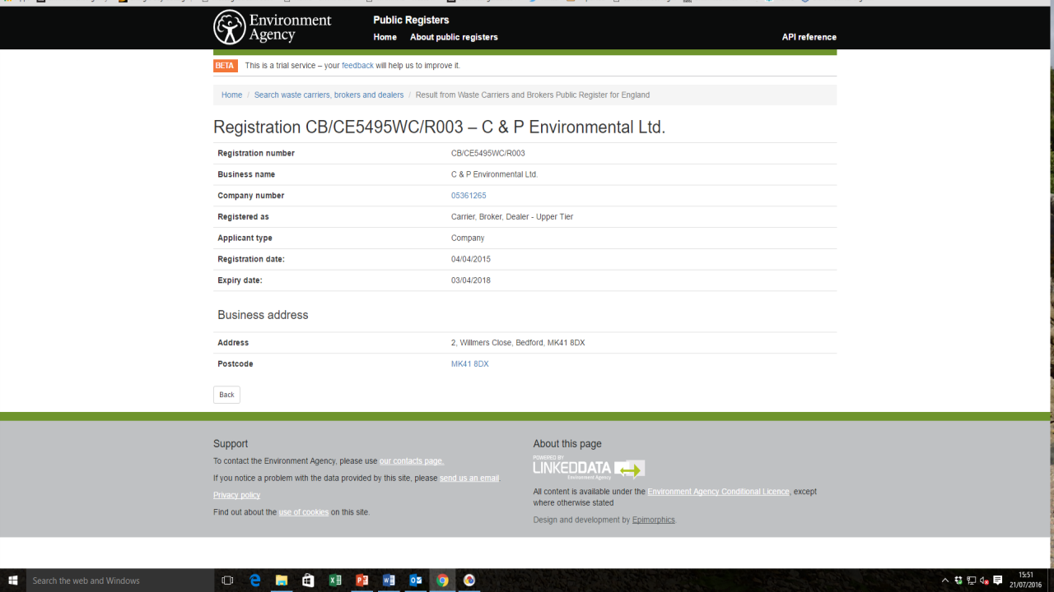

Slide 70
EPR 2010 – Types of Permit
Bespoke Permit
  Permit conditions
Standard Rules Permit
Exemptions, Schedule 3
  Range of requirements (Use, Treatment, Disposal and Storage)
Regulatory Position Statements (EA)
Low Risk Positions (EA)
You need to be aware of these, especially if you operate one or send waste to one!

Slide 71
Exemptions
Schedule 3 of the Environmental Permitting (E & W) Regulations 2010 (as amended)
  Part 1 – Exempt waste operations
All exemptions have descriptions and specific conditions
  For waste operations – U, T, D & S exemptions
All exemptions must be registered
  Lasts for 3 years
Notes:
Part 2 – Exempt water discharge activities
Part 3 – Exempt groundwater activities
Registered exemptions last for 3 years.
There are three waste treatment exemptions that you need to register with other authorities and not the Environment Agency. These are:
•T3 - treatment of waste metals and metal alloys by heating for the purposes of removing grease
•T7 - treatment of waste bricks, tiles and concrete by crushing, grinding or reducing in size
•T22 - treatment of animal by-product waste at a collection centre
You register T3 and T7 with the local authority where you have your principle place of business. If this is outside England and Wales, it should be with the local authority where the operation will be carried out.
You register T22 with the authority responsible for granting an authorisation under the Animal By-products Regulations.
There are some exemptions which don’t need to be registered. These are called non waste framework directive (NWFD) exemptions.
Waste exemption: NWFD 2 temporary storage at the place of production
This exemption allows you to temporarily store any waste at the place of production before it’s collected.
You can:
only store waste in a secure place at the place of production.
carry out some treatments on the waste to help with storage and collection
These treatments are only to make waste you have produced easier to store and collect for recovery or disposal somewhere else.
The treatments must not result in a change in the characteristics of the waste. Treatment must be purely to help with transport of collection of different wastes. Examples of such treatments include:
compacting paper and cardboard it increase the amount of waste that can be stored within a container
shredding confidential papers for security purposes
separating recyclables such as paper, card, plastic and glass from mixed wastes into separate containers
Key conditions - The waste must: be stored in a secure place and not be stored for longer than 12 months
Waste exemption: NWFD 3 temporary storage of waste at a place controlled by the producer
This exemption allows you to temporarily store waste you have produced when working away from your normal business premises.
It applies to organisations such as a medical or veterinary practice or a builder who carries out work at other premises and generates waste. Then the waste is brought back to the normal business premises and collected together.
Types of activity you can carry out:
you can only store waste that you have produced working elsewhere, in a secure place that you have control over
you can carry out some treatments on the waste to help with storage and collection, such as separating wastes into different types
This does not include any waste containing asbestos or any highly flammable waste
Quantity of waste you can store
At any one time you can store up to: 50 cubic metres of solid waste and/or 1,000 litres of liquid waste
Key conditions - if you store more than one type of waste, the different types must not be mixed and the waste must not be stored for longer than 3 months
Waste exemption: NWFD 4 temporary storage at a collection point
This exemption allows you to temporarily store waste at a collection point before recovering or disposing of the waste elsewhere.
For example:
a pharmacy which takes back and stores out of date medicines returned by patients or operates a needle exchange scheme
a shop which provides a container for customers to deposit waste batteries
a shop which provides a take back arrangement for Waste Electrical and Electronic Equipment (WEEE)
You can’t:
collect waste as your main business activity
receive payment for collecting the waste
store mixed waste
This does not include any waste containing asbestos or any highly flammable waste
At any one time you can store up to:
30 cubic metres of Waste Electrical and Electronic Equipment (WEEE)
50 cubic metres of non-hazardous waste that isn’t WEEE that will be recovered elsewhere
5 cubic metres of waste, other than those mentioned
Key conditions - if more than one type of waste is stored, the different types must not be mixed and you can only store waste temporarily; generally no longer than 3 months

Slide 72
Exemptions detail …
Specific activity exempted
EWC codes acceptable
Limiting conditions on quantities and sometimes time constraints
Storage requirements
Waste type specific requirements
If you are sending your waste to an exempt activity … duty of care still applies
Ask questions and remember ‘relevant objectives’
Notes:
Show gov.uk website for example if considered necessary and if time allows
S2 exemption ‘storage of waste in a secure place’ as an example
T4 also could be used
Exemptions in Scotland have similar details and types of restrictions and referred to as paragraph numbers
Examples of exemptions
Para 9 – land reclamation or improvement
Para 11 – preparatory treatment of certain wastes (baling, sorting or shredding)
Para 12 – composting
Para 13 – screening and blending of soils and construction materials
Para 19 – use of waste in construction
etc

Slide 73
Waste Exemptions – cause of concern
  EPR 2010 Storage, Treatment, Use and Disposal
Designed for limited
Waste quantities
types of waste
range of activities
https://www.gov.uk/waste-exemptions-disposing-of-waste
Caution
Check if your waste is going to an Exemption
ask questions, remember ‘relevant objectives’
Exemptions under review

Slide 74
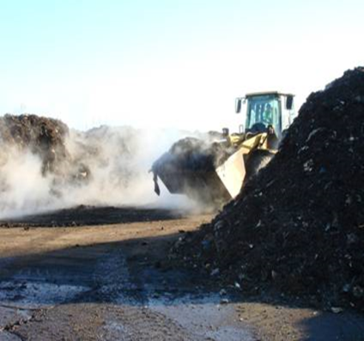
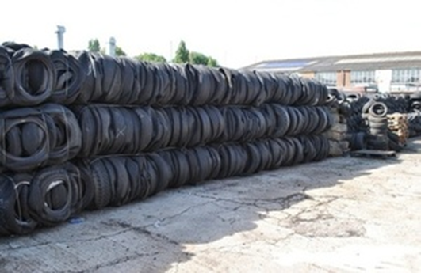
Examples of Exemptions
W/B P24
T23
T8

Slide 75
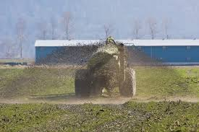
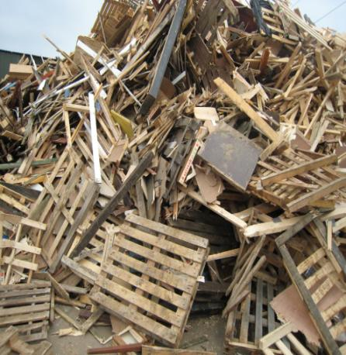
Examples of Exemption
U10
T6

Slide 76
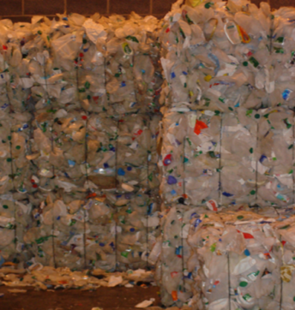
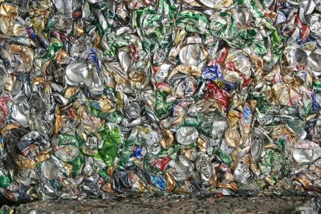
More examples of exemptions
T4
T9

Slide 77
Non registerable exemptions
Storage on sites
https://www.gov.uk/government/collections/waste-exemptions-storing-waste#storing-waste-exemptions-s1-s2-s3

Slide 78
Duty of Care Obligations
Adequate Written Description

Slide 79
To ensure written description of the waste on transfer
Waste transfer notes / written information
  Must accompany any transfer of waste between different holders
Regulations require parties on transfer of waste to complete, sign and retain copy (2 years)
Transfer note should contain [sufficient] information about the waste and about the parties to the transfer
Notes:
What are transfer notes -
A waste transfer note (WTN) is a document which must accompany any transfer of waste between different holders. The purpose of a WTN is to allow other people who handle your waste to know what they are dealing with so that they can manage it safely and properly.
Provide copy of a waste transfer note – to highlight the information required. Transfer notes can be very different depending on the contractor but there is a minimum information requirement
Describe season ticket

Slide 80
Regulation 35 requirements
Transfer Notes – minimum info
  completed and signed
  contain information on nature of waste, containment, place and time of transfer
  details of transferor and transferee
  List of Waste code (EWC)
  SIC code (2007)
  Hierarchy Declaration

Slide 81
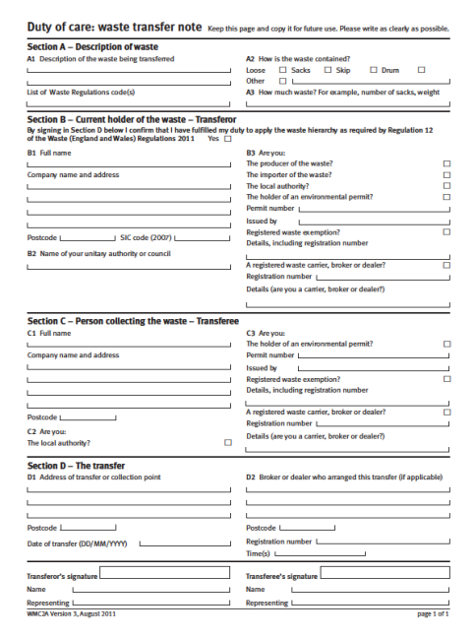
Transfer note/ Written Information
List of waste code (EWC)
Written description
Hierarchy declaration
SIC
Receiving holder
Season ticket
Signatures
edoc

Slide 82
Waste Transfer Note/ Written Information
W/B P27
SIC code of transferor is also required – 2007 SIC codes
Example SIC codes:
  38.11 Collection of non-hazardous waste
  38.12 Collection of hazardous waste
  39.00 Asbestos removal work
  28.11 Industrial engine parts (manufacture)
Notes:
Copy of transfer note to be provided to delegates

Slide 83
Waste Transfer Note/ Written information
Certificate number of any waste carrier / brokers registrations
Environmental permit / exemption numbers if relevant
Confirm that the transferor has applied the waste hierarchy as a priority order
Notes:
producer also includes any one who treats the waste resulting in a change – therefore a treatment plant / transfer station may be responsible for changing the description of the waste after treating / mixing etc and completing a new transfer note accordingly.

Slide 84
Adequate written description
W/B P29
Attach further information e.g. lists, analysis
Mis-description and coding issues are common
Brokers and Dealers are holders too
Follow Code of Practice
What other documentation might have these features

Slide 85
‘Adequate’ waste description
What makes up an adequate waste description?
  Are the following adequate descriptions?
    Mixed waste
    Contaminated soil
    Oily waste
    Non-hazardous general waste
    Off specification product (XBL54)
Notes:
Discussion

Slide 86
Season tickets
?
In what circumstances could a season ticket be used?
Notes:
A season ticket is a single waste transfer note that covers a series of waste transfers.
You can only use a season ticket if every load of waste in the series has the same details for all of the following:
description, eg it’s the same type of waste or the same mixture of types
collection point, eg it leaves from the same place
collector (‘transferee’), eg it’s taken by the same business

Slide 87
Written information - issues
25 Million
Non completion
Descriptions “Factory rubbish!” “Skip waste” (mis-description or lack of written description
List of Waste code
Segregation of wastes
Further information e.g. testing and analysis
Landfill requirements i.e. WAC
Pre-treatment
Waste Hierarchy compliance

Slide 88

edoc (www.edoconline.co.uk)

Slide 89
edoc
Electronic Duty of Care
Endorsed by industry
Replace up to 25m paper CWTN
80% use sought
Incorporates season ticket
Remember minimum reqd information!
How it works

Slide 90
edoc
Allows (amongst other things):
Online completion and signing of transfer notes
Single use or season tickets
Inbuilt weight conversion
Report compilation
Fully compliant with Duty of Care

Slide 91
Remember…
!
Duty of Care applies to all ‘wastes’
For hazardous wastes the transfer note requirements are covered by using a hazardous waste consignment note

Slide 92
Guidance – for determining whether a waste is hazardous
Environment Agency / SEPA / NRW
    Technical guidance WM3
    1st Edition (2015)
Consult a specialist

Slide 93
Hazardous Waste Controls – Eng & Wales
Premises registration – for hazardous waste producers (Wales only)
Consignment notes
Quarterly returns
Record keeping and registers for hazardous wastes
Notes:
Explain terminology
The Producer is the person whose activities produce the waste.
The Holder is the producer of the waste and/or the person who is in the possession of it.
The Consignor is the person who causes the waste to be removed from the premises at which it is produced or is being held.
The Carrier is the person who collects the consignment of hazardous waste from where it is produced (or is being held) and delivers it to a consignee.
The Consignee is the person to whom the waste is being transported for disposal or recovery

Slide 94
Premises registration - Wales
  All hazardous waste producers in Wales must register their premises with NRW
      Premises generating 500kg or more in a 12 month period
      Premises code ‘ABC123’
NB: producers in England no longer need to register with the Environment Agency.

Slide 95
Hazardous waste consignment notes
A consignment note must be completed to accompany ALL hazardous waste when it is moved from any premises
  Includes premises exempt from registration
  Movements between premises belonging to same company
  No de minimis quantity
Notes:
The only exception is where a hazardous waste is moved within the curtilages of the same premises.
A consignment note is required even if the holder of the waste does not change

Slide 96
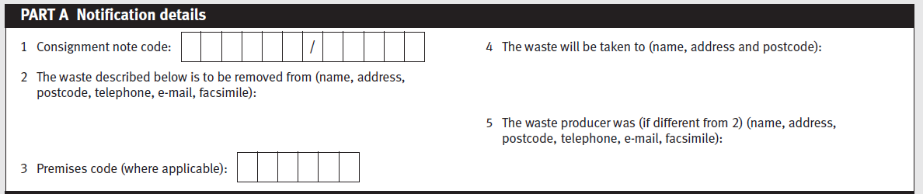
Notification details
First 6 digits will be the premises registration code (Wales) or first 6 characters of the organisation producing waste.
Second 5 digit code to complete unique ‘Consignment note code’
Waste producer’s responsibility for unique coding
Notes:
Delegates to have print outs of consignment notes
A consignment note code must be unique, and is valid for only one consignment.
For collections from a registered hazardous waste producer (Wales only) this must be:
• the 6 digit hazardous waste producer registration number, followed by
• ‘/’, followed by
•exactly 5 numbers or letters of your choosing, that produce a unique number for that collection
For example, ABC123/A0001.
If the premises is exempt from registration replace the premises code with EXE and any three letters or numbers of your choosing to produce a unique number, for example, EXEA12/A0001.
In England - refer to new EA guidance. The first 6 characters of the consignment code must be the first 6 letters or numbers (no symbols) of the business name. The producer should ensure consistent use of the org name in the is regard. Exempt will no longer be used. The second set of characters will continue to be five numbers or letters of the waste producer/holders choosing.
If the waste is fly-tipped replace the premises code with FLY and any three letters or number of your choosing to produce a unique number, for example, FLYA12/A0001.

Slide 97
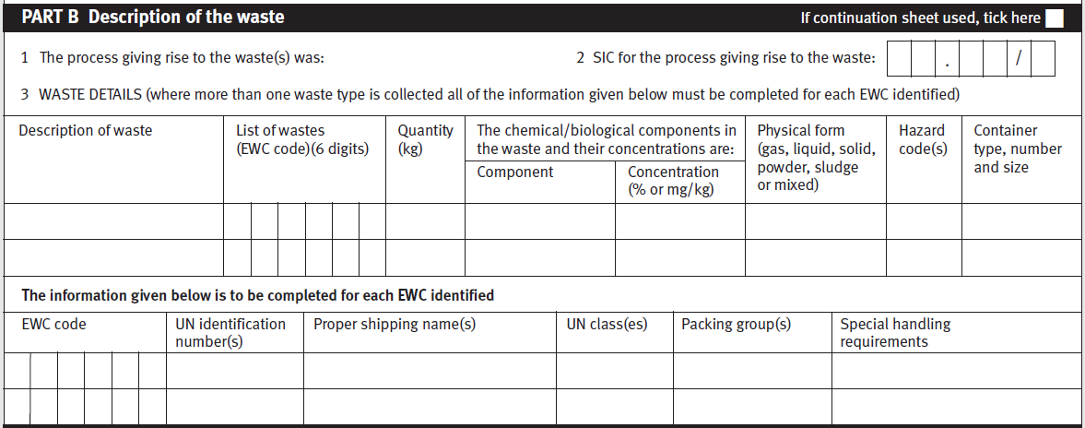
Waste details
Notes:
This course does not cover the carriage of dangerous goods requirements – mention the need to consult a specialist

Slide 98
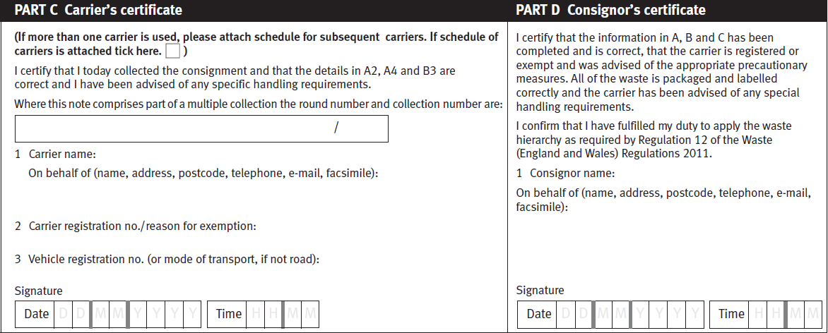
Responsibilities
If multiple collection – round and collection number required
Waste hierarchy declaration
Notes:
Read out he consignor’s declaration and highlight the importance of ‘competency’ and understanding for whoever signs this.

Slide 99
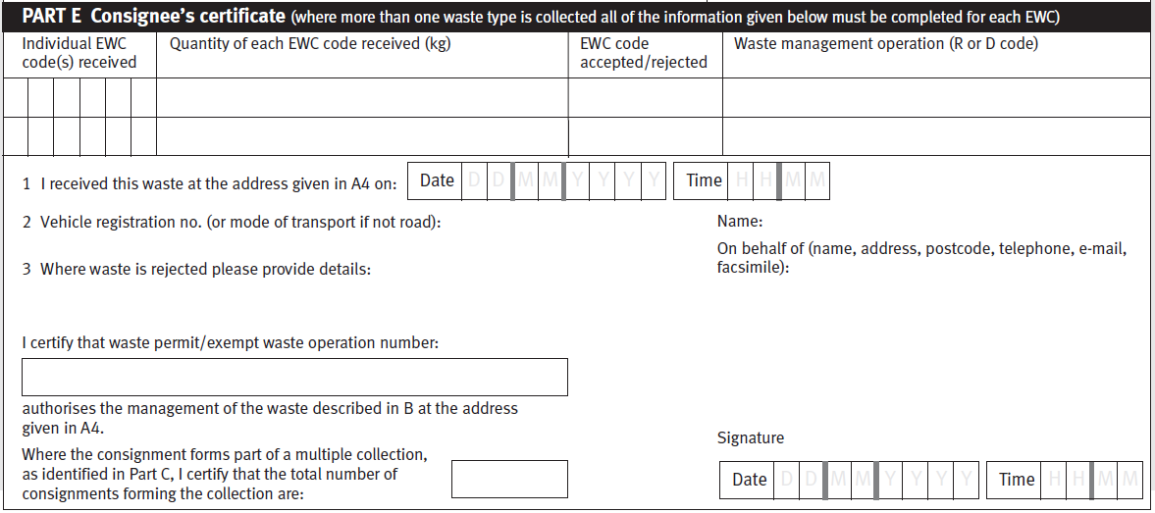
Consignee’s certificate
‘R’ and ‘D’ codes – from Waste Framework Directive and listed in environmental permits as authorised activities
Notes:
Include list of R & D codes in work book
Summary of consignment note procedure in workbooks

Slide 100
Quarterly returns and record keeping
  Quarterly returns
    From the consignee to the Regulator (fee payable)
    From the consignee to the waste producer
  Record keeping
    Copies of consignment notes
    Quarterly returns
    3 years for waste producer
Notes:
Highlight that quarterly returns from the consignee to the waste producer enables closing of the duty of care ‘loop’ – and provides evidence of the cradle to grave nature of moving hazardous waste.
By end of the month after the end of each quarter.
Records should include copies of consignment notes, carriers schedules (if the waste is transferred between carriers/vehicles) and copies of any consignment notes for rejected wastes
Waste producers keep records for minimum 3 years
Carriers for minimum 12 months
For consignees:
- Landfill (disposal codes D1 to D6 and D12) - As long as you have a permit
- Other waste site with a permit - 5 years
- Other waste site with a permit - As long as you have a permit
- Waste sites with an exemption - 3 years
Haz waste returns info and link to spreadsheet
https://www.gov.uk/guidance/hazardous-waste-returns-supplementary-guidance
https://naturalresources.wales/waste/hazardous-waste-returns/?lang=en

Slide 101
Mixing of Hazardous and Non Hazardous wastes
Prohibition on mixing hazardous waste without a permit
19.— (1) Subject to paragraphs (2) and (3), no establishment or undertaking which carries out the disposal or recovery of hazardous waste, or which produces, collects or transports hazardous waste, shall mix any hazardous waste.
(2) Paragraph (1) does not apply so as to prohibit a process by which waste is produced and which results in the production of mixed wastes, being a process other than one which mixes a waste with any other waste, substance or material, resulting in —
(a) a change in the nature or composition of that waste;
(b) or the production of another waste.

Slide 102
Putting it all into practice

Slide 103
Producer responsibilities
Ensure that any waste you produce is handled and stored safely, without causing harm to the environment and in accordance with the law
Know the nature of your waste, for example if it is waste from one of your processes you will be best placed to know its properties

Slide 104
Exercise 1 – coding a waste
W/B P33
You are a waste carrier and have been asked to collect 80x 205l drums of ‘aqueous liquid waste containing printing ink’ from a printing works:
What 6-digit EWC code would you allocate? Justify the logic used.
On arrival at site you find that shown in Figure 1. What level of confidence do you have that the waste is accurately described?
Does anything you see in Figure 1 give cause for concern about general management control?
While on site you are also asked if you would take away the drum shown in Figure 2. Would you do so, and if not, why?

Slide 105
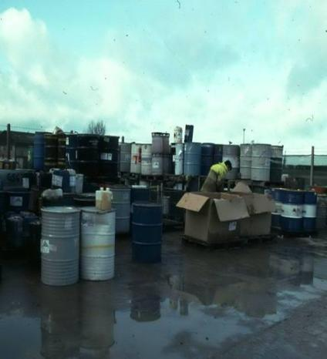
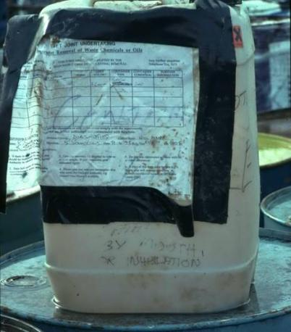
Exercise 1 - photos
Fig 1.
Fig 2.

Slide 106
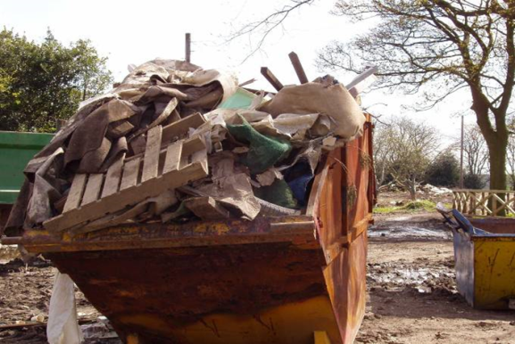
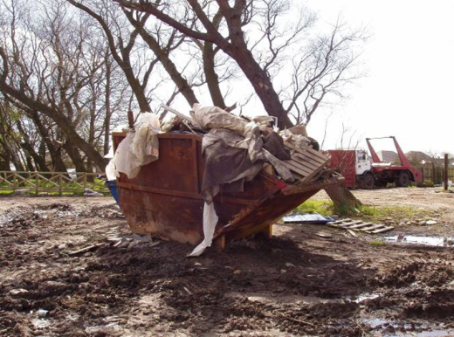
Exercise 2 – coding skip waste
W/B P34

Slide 107
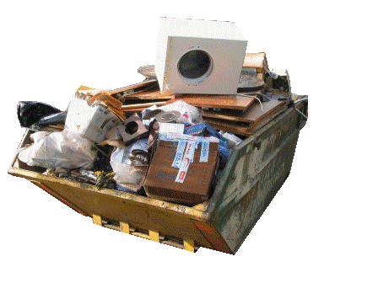
‘skip waste’
Consider;
  Where are skips used
  Who might use them
  What might be in them
  Who determines where the waste is taken

Slide 108
What does this mean in practice?
Plan how you will apply the waste hierarchy
Monitor performance regularly
Know what wastes you are producing and make efforts to produce less
  Note good practice to record initiatives that may prevent waste / or move up the hierarchy
Sort and segregate wastes
Notes:
WRAP Waste Hierarchy e-publication Guide

Slide 109
Exercise 3
W/B P35
You are responsible for waste management for your company – [1] a retailer with premises within a shopping centre.
A [2] facilities management company have arranged for a [3] waste contractor to remove waste from all shops within the centre.
What is the role of the three (underlined) parties within the ‘waste chain’?
Who carries the main responsibility for ensuring DoC compliance?
What should each party do to ensure compliance with written description requirements?

Slide 110
Review
W/B P36
What are the Obligations
Who do these obligations apply to
Do they apply equally
What does a transfer note require
What ‘evidence’ do I need e.g. hierarchy
What weaknesses might the Duty have
What should you do if something goes wrong

Slide 111
Code of practice & responsibilities

Slide 112
Where does responsibility rest?
Who has primary responsibility?
Who else might be involved?
Where can help be obtained?
What is good/bad practice?
Consider Code of Practice guidance

Slide 113
‘Holders’ responsibilities
W/B P37
Section 34 EPA90 says that “A holder is expected to take measures that are:
1. Reasonable in the circumstances &
2. Applies to him in his capacity
and “know or foresee”
What does this mean?
Find out in; Code of Practice

Slide 114
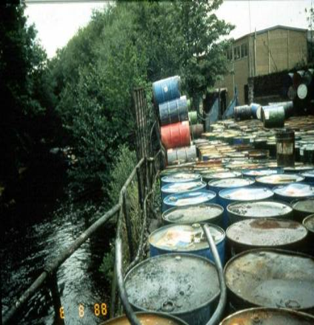
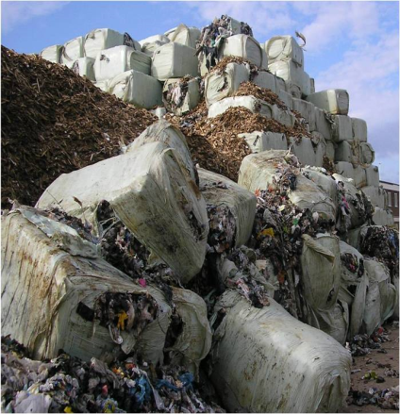
‘Reasonable’ & ‘Know or foresee’

Slide 115
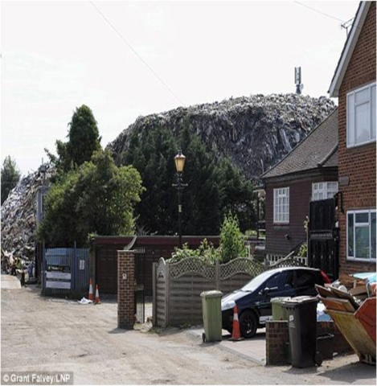
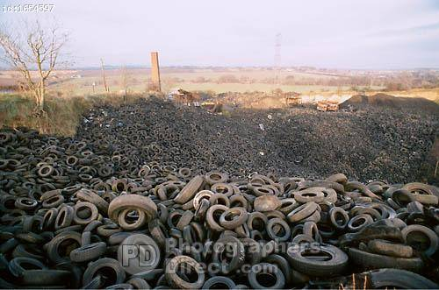
So how does this happen? Today!

Slide 116
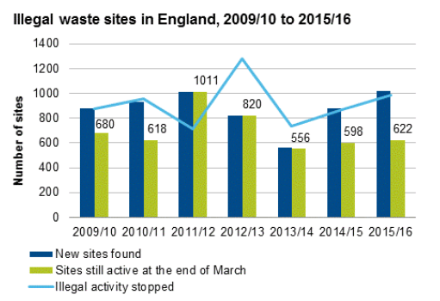
Unauthorised Sites

Slide 117
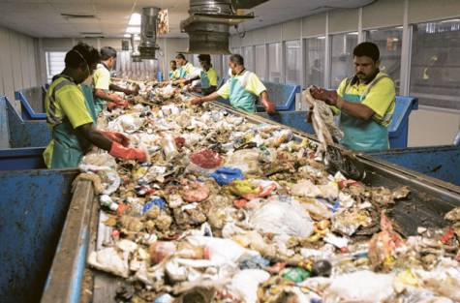
Transfer stations and “MRF’s”
W/B P38
Consider
can your waste be managed safely
Are there any compatibility
issues with other wastes
how your waste will be managed/packaged
the accuracy of waste descriptions and type of packaging
Understand where your obligations end in light of
Outputs and destinations

Slide 118
Exercise 5 - treatment
W/B P39
Waste wood from a transfer station is shredded and to be sent to a compost site producing PAS 100 compost
What would be the EWC code for this wood
Is this acceptable
What must happen to the wood
If you were the compost site operator what should you be concerned about

Slide 119
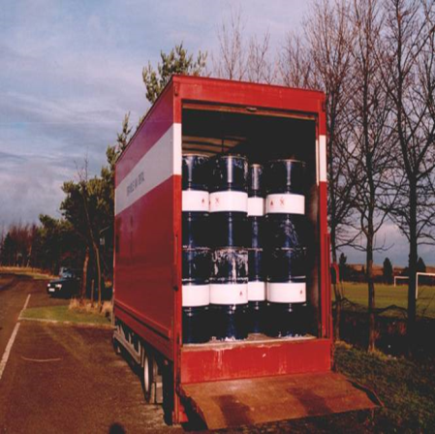
Exercise 6
W/B P40
The Agency has stopped a vehicle on the road to find that shown.
Would you as the person responsible for waste management on behalf of the producer have any concerns?
If so, Why?

Slide 120
Auditing the waste chain
Notes:
This section will cover:
Waste hierarchy

Slide 121
W/B P41
Auditing the waste chain
Why ‘audit’?
What might an audit consist of?
What are the objectives?
What would you use the information for?
Sources of information

Slide 122
Auditing the waste chain
What are we auditing against ……. ?
What information do we need to demonstrate that we have acted reasonably?

Slide 123
Auditing waste management sites
Are you an expert in landfill or waste incineration or waste treatment - Probably not! But…..
You can spot where things are not quite right
Also, some waste managers are now starting to audit UP the chain

Slide 124
W/B P42
Exercise 7
For each of the four Duty of Care obligations:
As a waste producer - what information will you seek and from where can it be obtained?
Does the type of (producer) site influence the above?
Does the final destination (waste management site) influence the above?
Notes:
Section 34 (1) of EPA90 -
prevent any contravention by any other person of s33 (permits)
prevent the escape of waste
transfer only to an ‘authorised person’
to ensure a written description of the waste on transfer (CWTN)

Slide 125
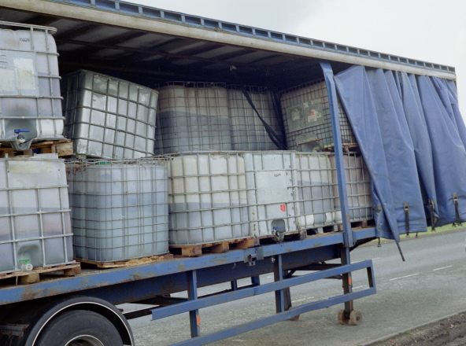
Remember - ‘know or foreseen’!
W/B P43
What happened here?
How could it have been prevented?
Who should have prevented?

Slide 126
Summary and Review

Slide 127
?
How would you summarise your obligations under Duty of Care?
Notes:
Can your waste be managed safely
Are you providing an adequate description of waste to the carrier/permitted facility?
Ensure waste is adequately contained and secured on your site and on the vehicle when passed to a carrier
Have you checked that the carrier is registered
Where is the waste going and have you undertaken appropriate checks?
Can the facility accept the waste?
Are they generally compliant with their permit?
Have you checked the waste was received?
Keep appropriate records
Don’t ’knowingly permit’ others to breach the regulations
Ensure that any waste you produce is handled and stored safely, without causing harm to the environment and in accordance with the law
Know the nature of your waste, for example if it is waste from one of your processes you will be best placed to know its properties
Take care of the waste while you hold it, for example during storage, so it does not escape from your control
Ensure your waste is transferred to someone who is authorised to receive it, for example, a registered waste carrier or waste manager with the relevant environmental permit

Slide 128
In summary - Key Principles of Duty of Care
W/B P44
The “Duty of Care” enshrines in law the requirement for all producers, carriers, importers, exporters, brokers, dealers and managers of controlled waste to manage that waste correctly by:
  storing it properly and managing risks,
  only transferring it to the appropriate people and
  ensuring that when it is transferred it is sufficiently well described to enable its safe recovery or disposal without harming the environment

Slide 129

Any Questions?

Slide 130
Conclusion and Course review
Course aims and objective
Your learning objectives
Key obligations
Legislative framework
Up to date and future changes
Questions and discussion

Slide 131
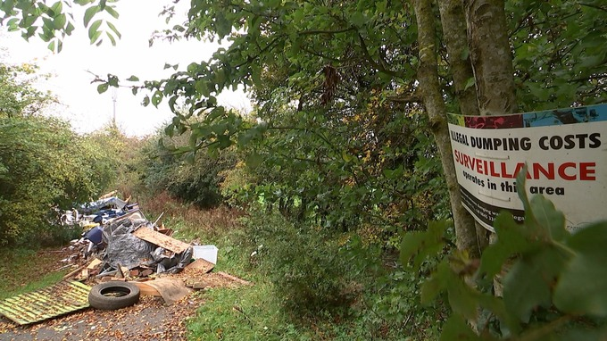

Slide 132
Duty of Care

